Slide 1

End Times
What does God want us to know?

Slide 2
II Timothy 2:2
And the things that thou hast heard of me among many witnesses, the same commit thou to faithful men, who shall be able to teach others also.

Slide 3
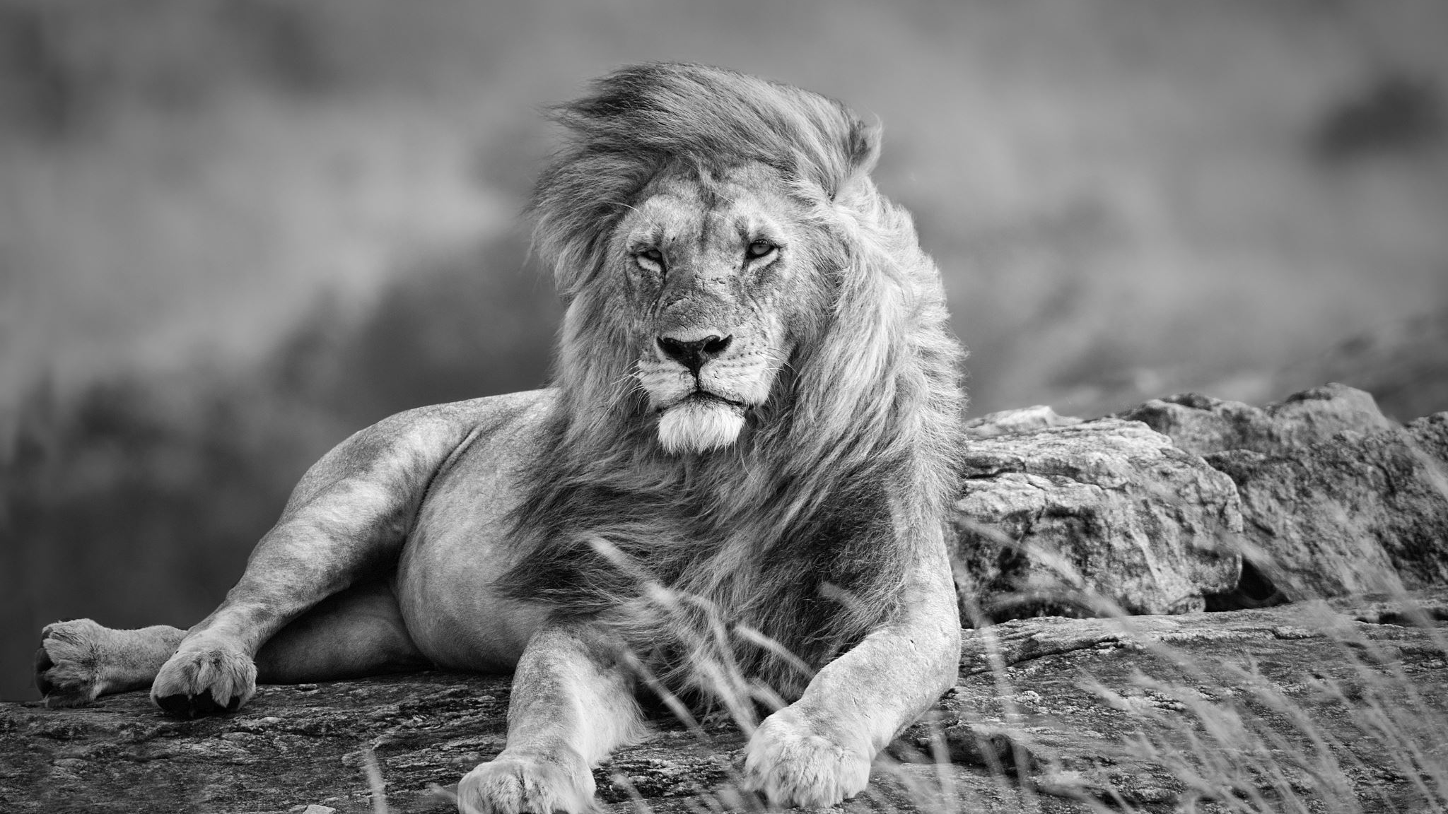
Paul to Timothy, his faithful disciplae
2 Timothy 4:8 Henceforth there is laid up for me a crown of righteousness, which the Lord, the righteous judge, shall give me at that day: and not to me only, but unto all them also that love his appearing.

Slide 4
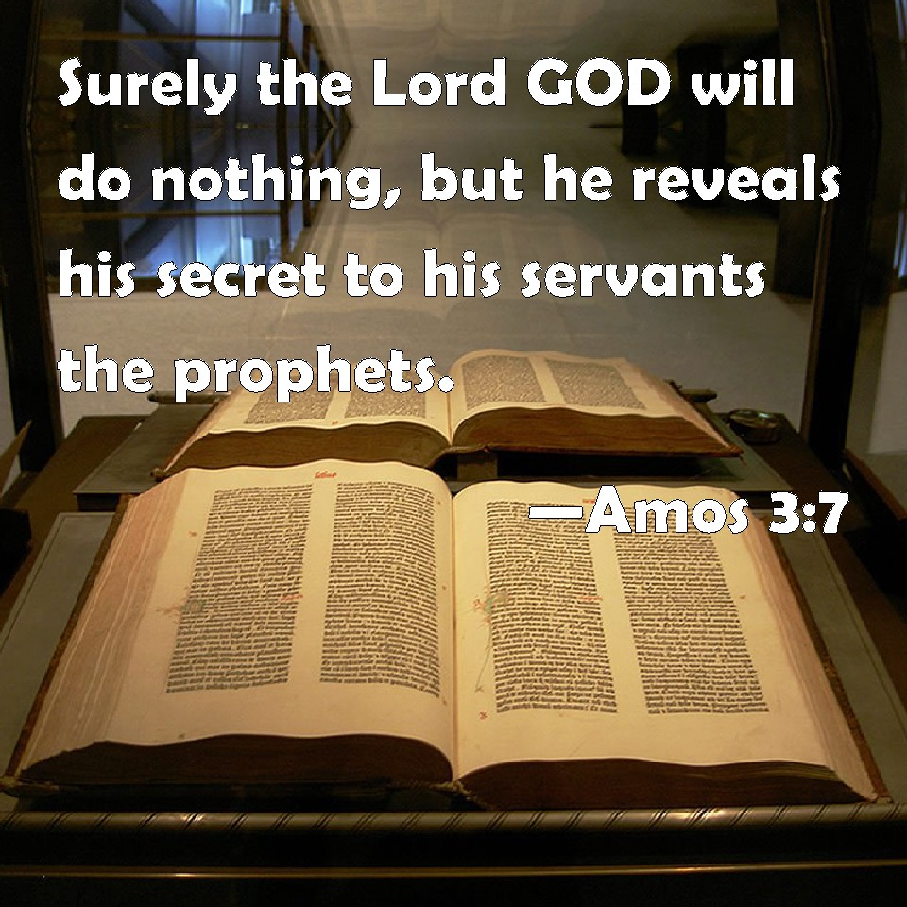
Amos 3:7

Slide 5
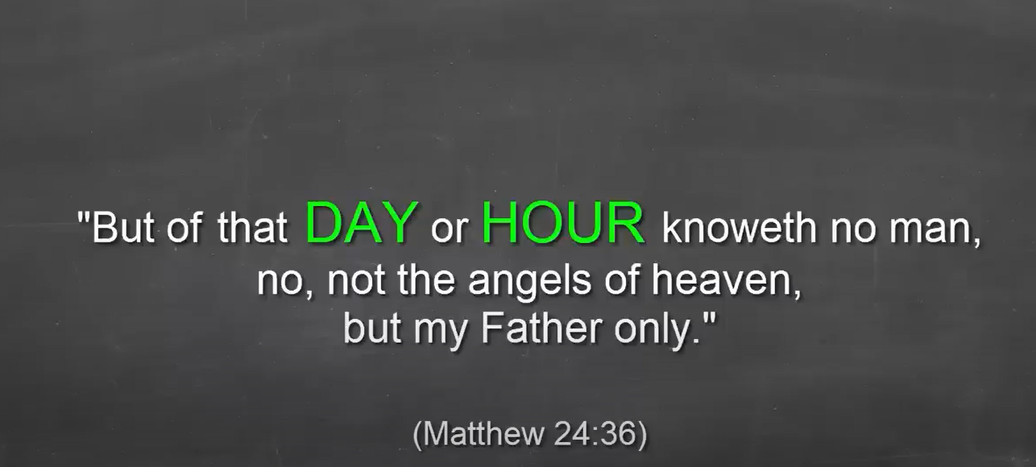
When will Christ return?

Slide 6
Matthew 24:35-37
Matthew 24:35-37
King James Version
35 Heaven and earth shall pass away, but my words shall not pass away.
36 But of that day and hour knoweth no man, no, not the angels of heaven, but my Father only.
37 But as the days of Noah were, so shall also the coming of the Son of man be.

Slide 7
Mark 13:32
31 Heaven and earth shall pass away: but my words shall not pass away.
32 But of that day and that hour knoweth no man, no, not the angels which are in heaven, neither the Son, but the Father.
33 Take ye heed, watch and pray: for ye know not when the time is.
34 For the Son of Man is as a man taking a far journey, who left his house, and gave authority to his servants, and to every man his work, and commanded the porter to watch.
35 Watch ye therefore: for ye know not when the master of the house cometh, at even, or at midnight, or at the cockcrowing, or in the morning:
36 Lest coming suddenly he find you sleeping.
37 And what I say unto you I say unto all, Watch.

Slide 8
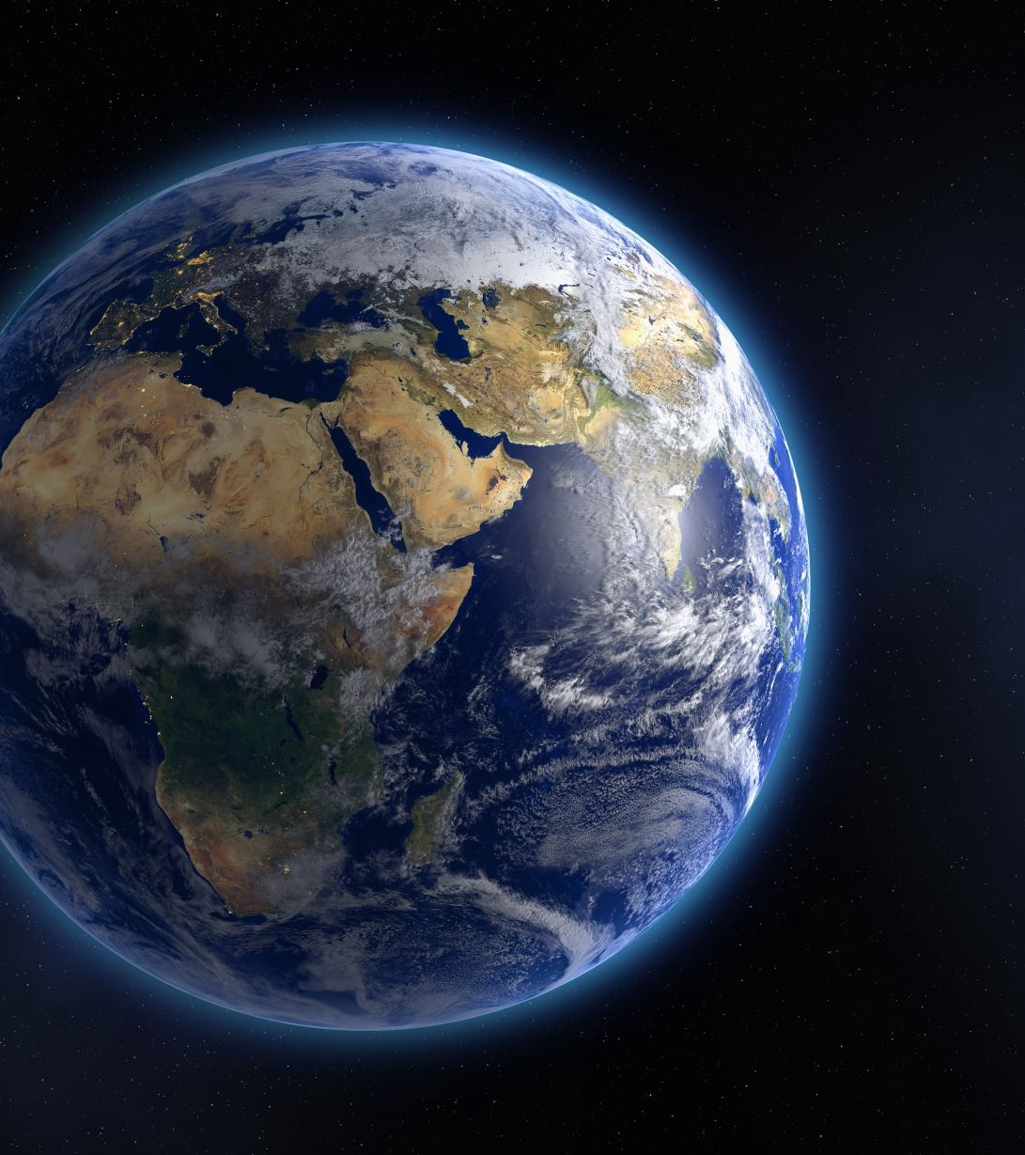
Theory to Consider
First Heaven and Earth – prior to Genesis
Second Heaven and Earth – created in Genesis
Third Heaven and Earth – after the Millennium

Slide 9
Revelation 20:6-7 and 21:1
6 Blessed and holy is he that hath part in the first resurrection: on such the second death hath no power, but they shall be priests of God and of Christ, and shall reign with him a thousand years.
7 And when the thousand years are expired, Satan shall be loosed out of his prison,
8 And shall go out to deceive the nations which are in the four quarters of the earth, Gog, and Magog, to gather them together to battle: the number of whom is as the sand of the sea.
21:1 And I saw a new heaven and a new earth: for the first (former) heaven and the first earth were passed away; and there was no more sea.

Slide 10
Former (second heaven and earth)
New World Translation (NWT): "And I saw a new heaven and a new earth; for the former heaven and the former earth had passed away, and the sea is no more." JW.ORGWatchtower
New American Bible Revised Edition (NABRE): "Then I saw a new heaven and a new earth. The former heaven and the former earth had passed away, and the sea was no more." USCCBBible Hub
Common English Bible (CEB): "Then I saw a new heaven and a new earth, for the former heaven and the former earth had passed away, and the sea was no more." Revelation 21:1 - Compare Bible Verse Translations | Bible Study Tools
The Scriptures 2009 (TS2009): "And I saw a renewed heaven and a renewed earth, for the former heaven and the former earth had passed away, and the sea is no more."
Ḥazon (Revelation) 21:1 And I saw a renewed heaven and a renewed earth, for the former heaven and the former earth had passed away, and the sea is no more. | The Scriptures 2009 (TS2009) | Download The Bible App Now
These translations specifically choose the word "former" to emphasize the contrast between what was and what is to come. Other translations use terms like "first" (NIV, ESV, KJV), "old" (CJB), or "original" in other versions, but the translations listed above deliberately use "former" to convey the sense of something that previously existed but has now been replaced or superseded.
The use of "former" particularly emphasizes the temporal aspect - that these were the heaven and earth that existed before, but are now passing away to make room for the new creation described in John's vision.

Slide 11
Genesis 1:1-2
The word for “was” – hayah – is the same word used in Genesis 19:26 where Lot’s wife was (hayah) turned into a pillar of salt. The implication is that the word hayah is not simply descriptive, but is active. Furthermore, the word “vav” for “and” can also be read as “but” depending on the context. In the Septuagint it has actually been translated this way. Thus Genesis 1:2 could, or should, read;
“But the earth became (or “had become”) without form, and void”.
1 In the beginning God created the heaven and the earth.
2 And the earth was without form, and void; and darkness was upon the face of the deep. And the Spirit of God moved upon the face of the waters.

Slide 12
Fall of Satan
Satan’s fall from heaven is symbolically described in Isaiah 14:12–14 and Ezekiel 28:12–18. While these two passages are referring specifically to the kings of Babylon and Tyre, we believe they also reference the spiritual power behind those kings, namely, Satan.
These passages describe why Satan fell, but they do not say when the fall occurred. Jesus, the eternal Son of God, witnessed Satan’s fall, and He mentions it in Luke 10:18: “I saw Satan fall like lightning from heaven.”
We know that the angels were created before the earth (Job 38:4–7). Satan fell before he tempted Adam and Eve in the Garden (Genesis 3:1–14). Satan’s fall, therefore, must have occurred somewhere after the time the angels were created and before he tempted Adam and Eve in the Garden of Eden. Whether Satan’s fall occurred hours, days, or years before he tempted Adam and Eve in the Garden, Scripture does not say.
The fall of Satan may be the reason the earth became without form and void.

Slide 13
II Peter 3
⁴ And saying, Where is the promise of his coming? for since the fathers fell asleep, all things continue as they were from the beginning of the creation.
⁵ For this they willingly are ignorant of, that by the word of God the heavens were of old, and the earth standing out of the water and in the water:
⁶ Whereby the world that then was, being overflowed with water, perished:
⁷ But the heavens and the earth, which are now, by the same word are kept in store, reserved unto fire against the day of judgment and perdition of ungodly men.
⁸ But, beloved, be not ignorant of this one thing, that one day is with the Lord as a thousand years, and a thousand years as one day.
⁹ The Lord is not slack concerning his promise, as some men count slackness; but is longsuffering to us-ward, not willing that any should perish, but that all should come to repentance.
¹⁰ But the day of the Lord will come as a thief in the night; in the which the heavens shall pass away with a great noise, and the elements shall melt with fervent heat, the earth also and the works that are therein shall be burned up.
¹¹ Seeing then that all these things shall be dissolved, what manner of persons ought ye to be in all holy conversation and godliness,
¹² Looking for and hasting unto the coming of the day of God, wherein the heavens being on fire shall be dissolved, and the elements shall melt with fervent heat?
¹³ Nevertheless we, according to his promise, look for new heavens and a new earth, wherein dwelleth righteousness.

Slide 14
New Heavens and Earth
Revelation 21:1 And I saw a new heaven and a new earth: for the first heaven and the first earth were passed away; and there was no more sea.
Revelation 20:7 And when the thousand years are expired, Satan shall be loosed out of his prison,

Slide 15
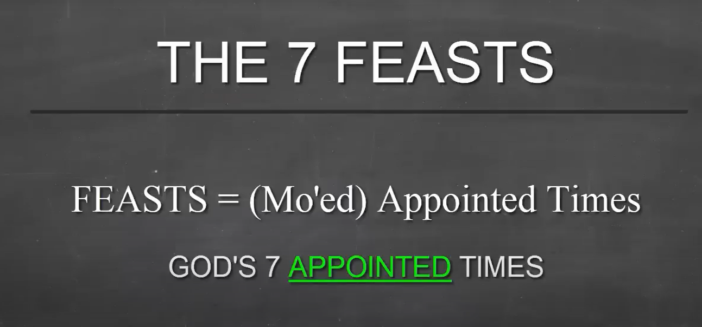
Appointed Times

Slide 16
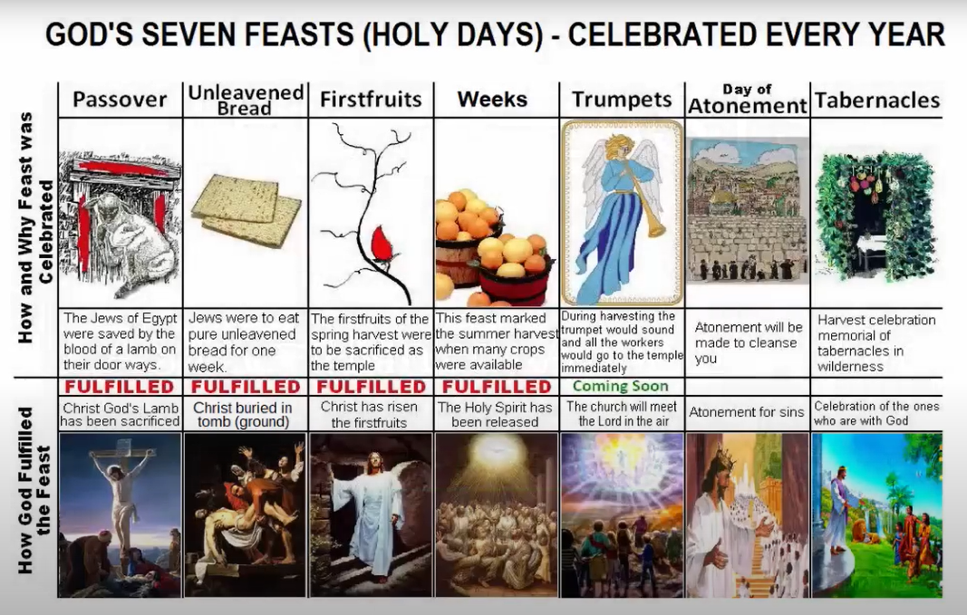
Heb 10:1 For the law having a shadow of good things to come, and not the very image of the things, can never with those sacrifices which they offered year by year continually make the comers thereunto perfect.

Slide 17
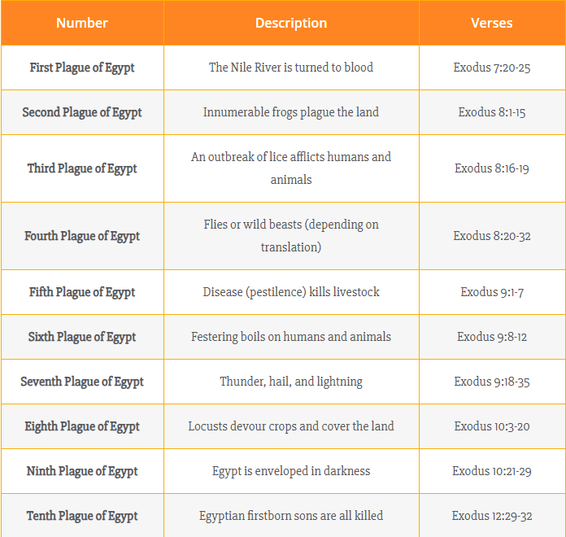
10 Plagues of Egypt

Slide 18
Passover
12 And the Lord spake unto Moses and Aaron in the land of Egypt saying,
² This month shall be unto you the beginning of months: it shall be the first month of the year to you.
³ Speak ye unto all the congregation of Israel, saying, In the tenth day of this month they shall take to them every man a lamb, according to the house of their fathers, a lamb for an house:
⁴ And if the household be too little for the lamb, let him and his neighbour next unto his house take it according to the number of the souls; every man according to his eating shall make your count for the lamb.
⁵ Your lamb shall be without blemish, a male of the first year: ye shall take it out from the sheep, or from the goats:
⁶ And ye shall keep it up until the fourteenth day of the same month: and the whole assembly of the congregation of Israel shall kill it in the evening.
⁷ And they shall take of the blood, and strike it on the two side posts and on the upper door post of the houses, wherein they shall eat it.
⁸ And they shall eat the flesh in that night, roast with fire, and unleavened bread; and with bitter herbs they shall eat it.
⁹ Eat not of it raw, nor sodden at all with water, but roast with fire; his head with his legs, and with the purtenance thereof.
¹⁰ And ye shall let nothing of it remain until the morning; and that which remaineth of it until the morning ye shall burn with fire.
¹¹ And thus shall ye eat it; with your loins girded, your shoes on your feet, and your staff in your hand; and ye shall eat it in haste: it is the Lord's passover.
¹² For I will pass through the land of Egypt this night, and will smite all the firstborn in the land of Egypt, both man and beast; and against all the gods of Egypt I will execute judgment: I am the Lord.
¹³ And the blood shall be to you for a token upon the houses where ye are: and when I see the blood, I will pass over you, and the plague shall not be upon you to destroy you, when I smite the land of Egypt.
¹⁴ And this day shall be unto you for a memorial; and ye shall keep it a feast to the Lord throughout your generations; ye shall keep it a feast by an ordinance for ever.

Slide 19
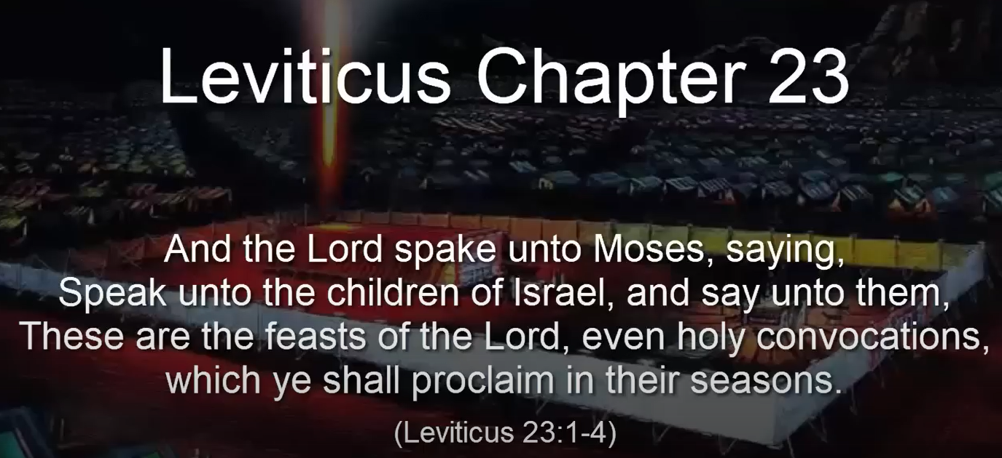
Holy Convocations

Slide 20
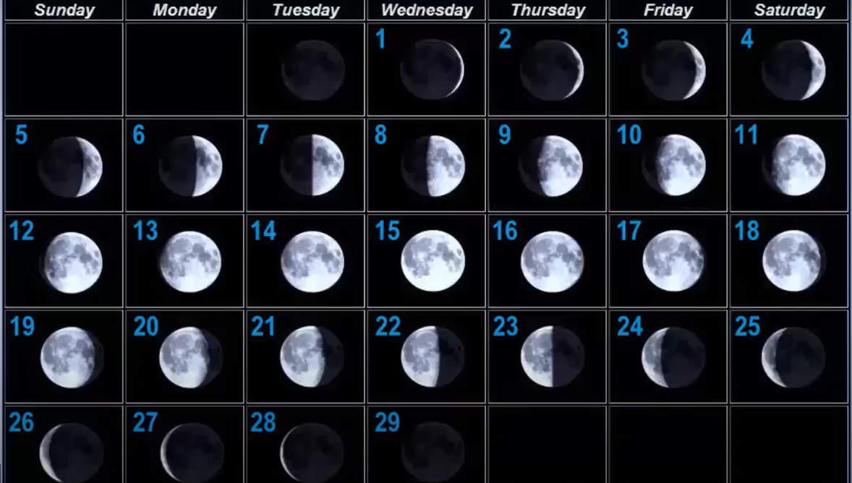
Lunar Calendar – 360 days

Slide 21
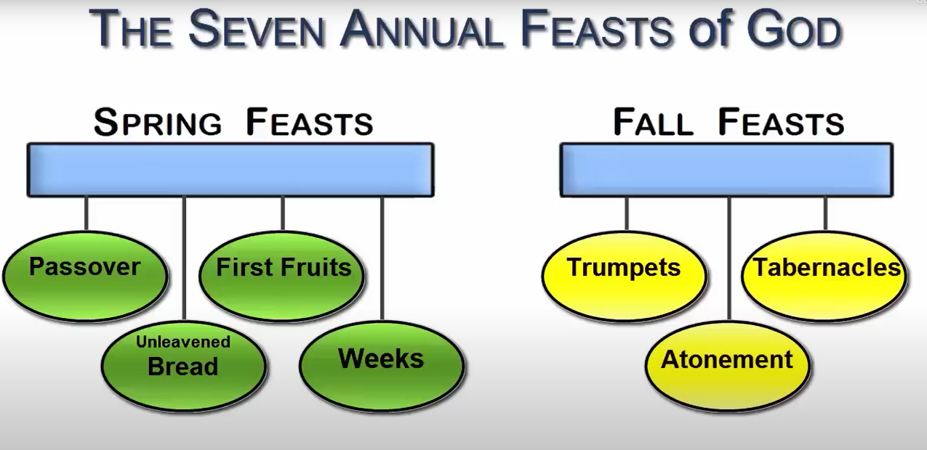

Slide 22
Exodus 23:14 – 3 times a year
Three times thou shalt keep a feast unto me in the year. Thou shalt keep the feast of unleavened bread: (thou shalt eat unleavened bread seven days, as I commanded thee, in the time appointed of the month Abib; for in it thou camest out from Egypt: and none shall appear before me empty:)
And the feast of harvest, the firstfruits of thy labours, which thou hast sown in the field: and the feast of ingathering, which is in the end of the year, when thou hast gathered in thy labours out of the field.
Three times in the year all thy males shall appear before the Lord GOD.

Slide 23
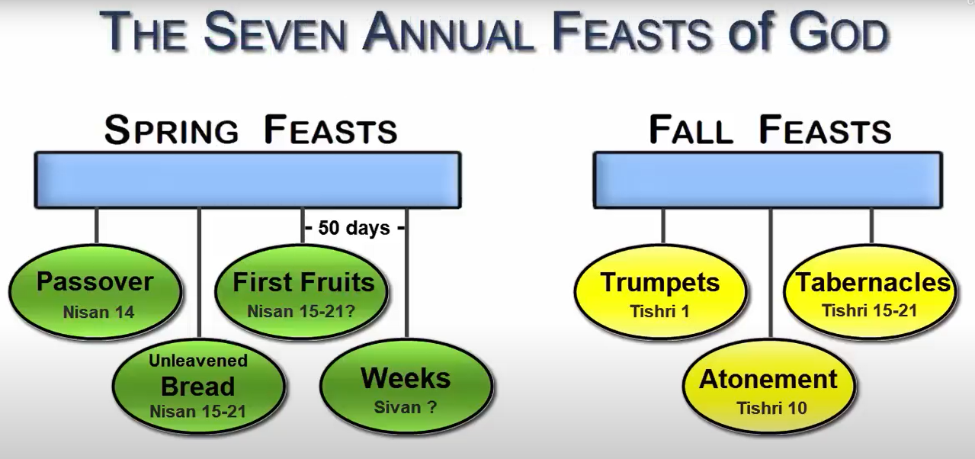

Slide 24
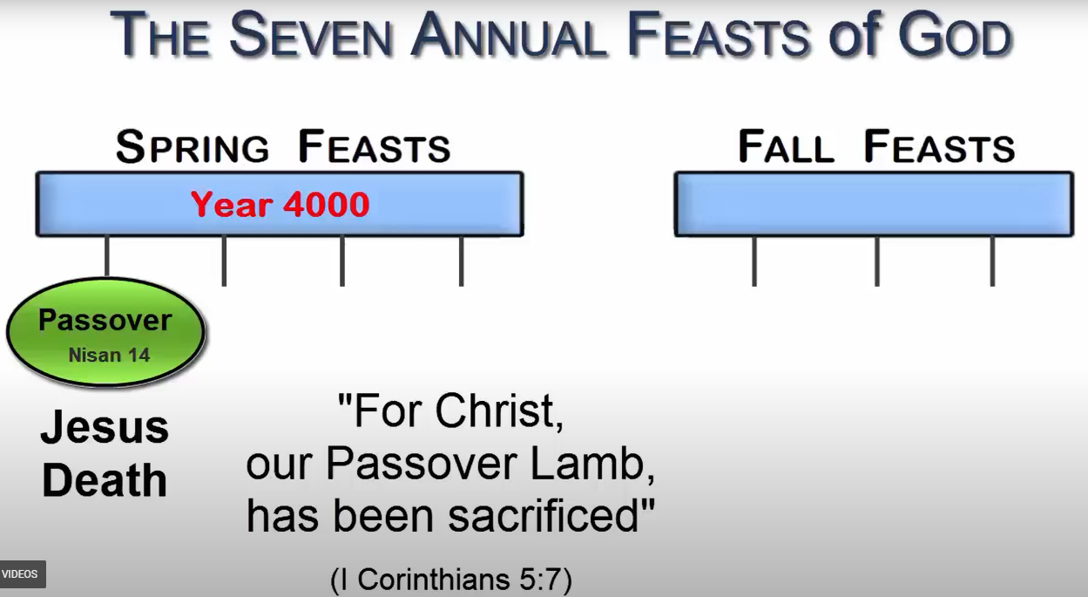

Slide 25
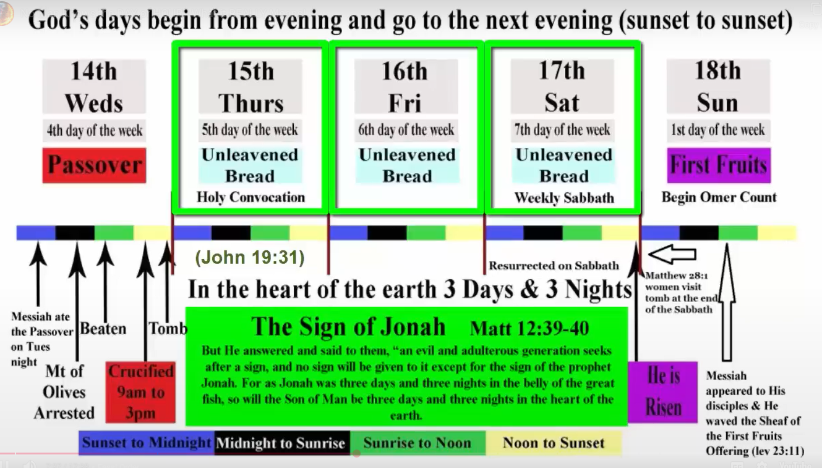

Slide 26
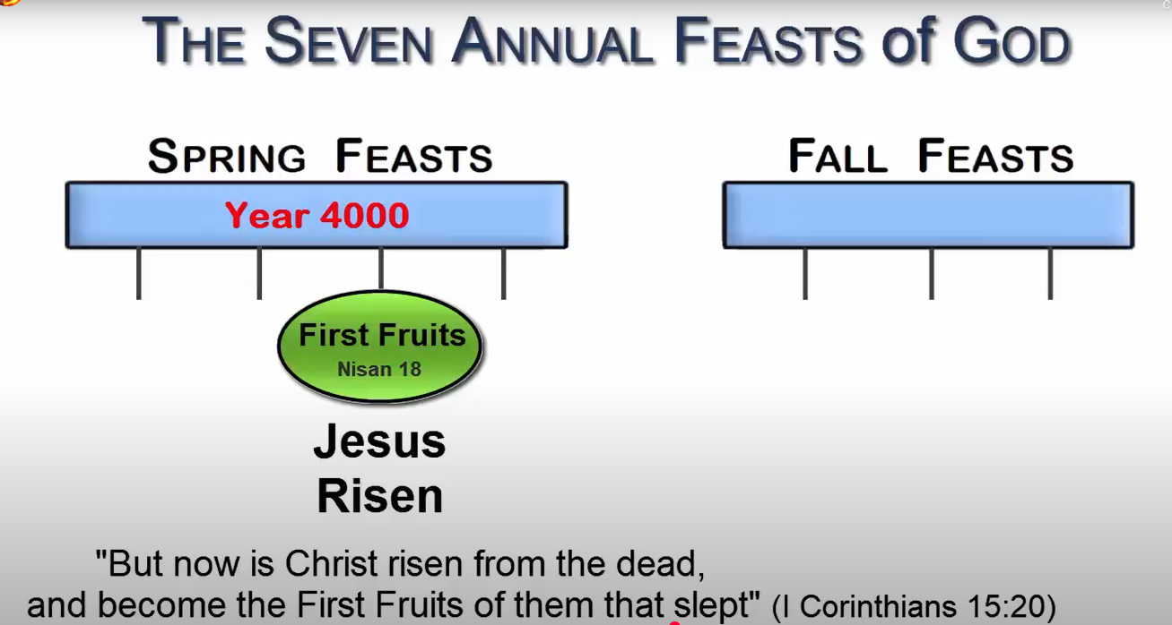

Slide 27
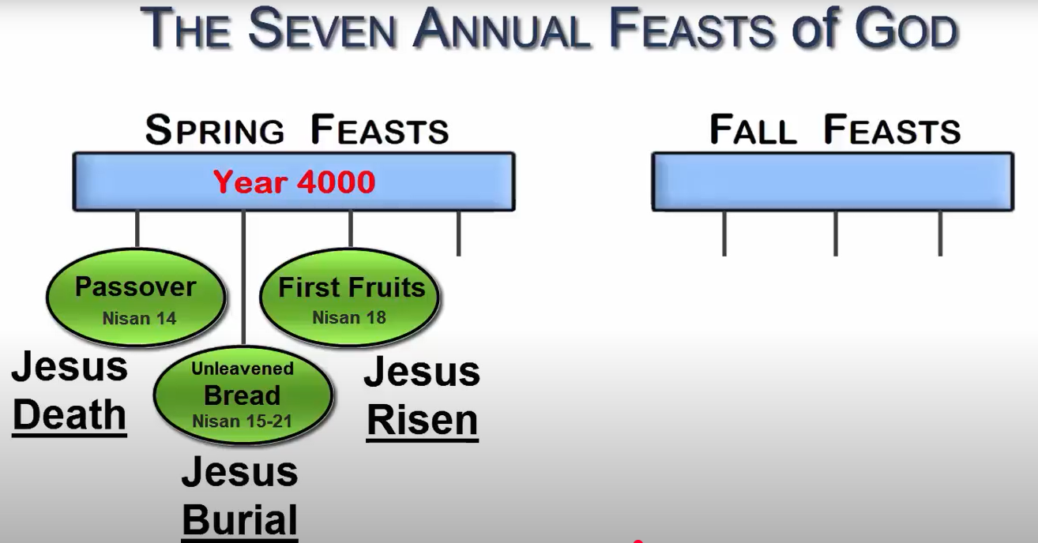

Slide 28
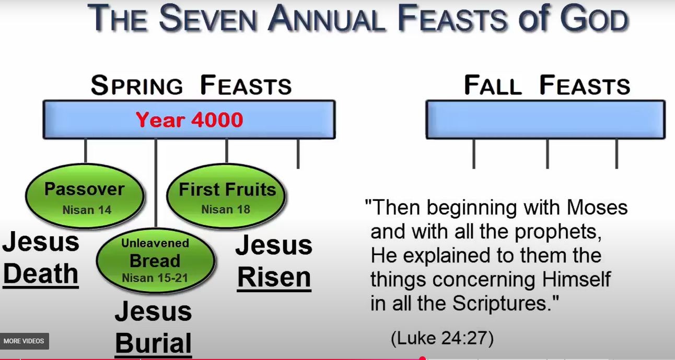

Slide 29
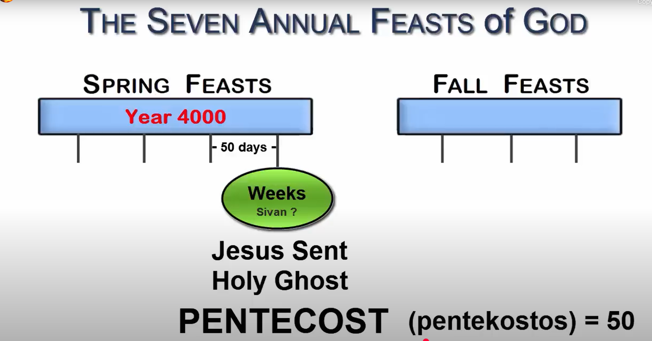

Slide 30
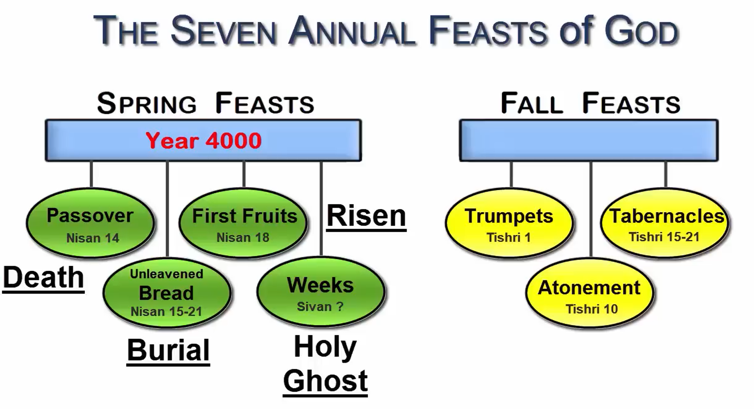

Slide 31
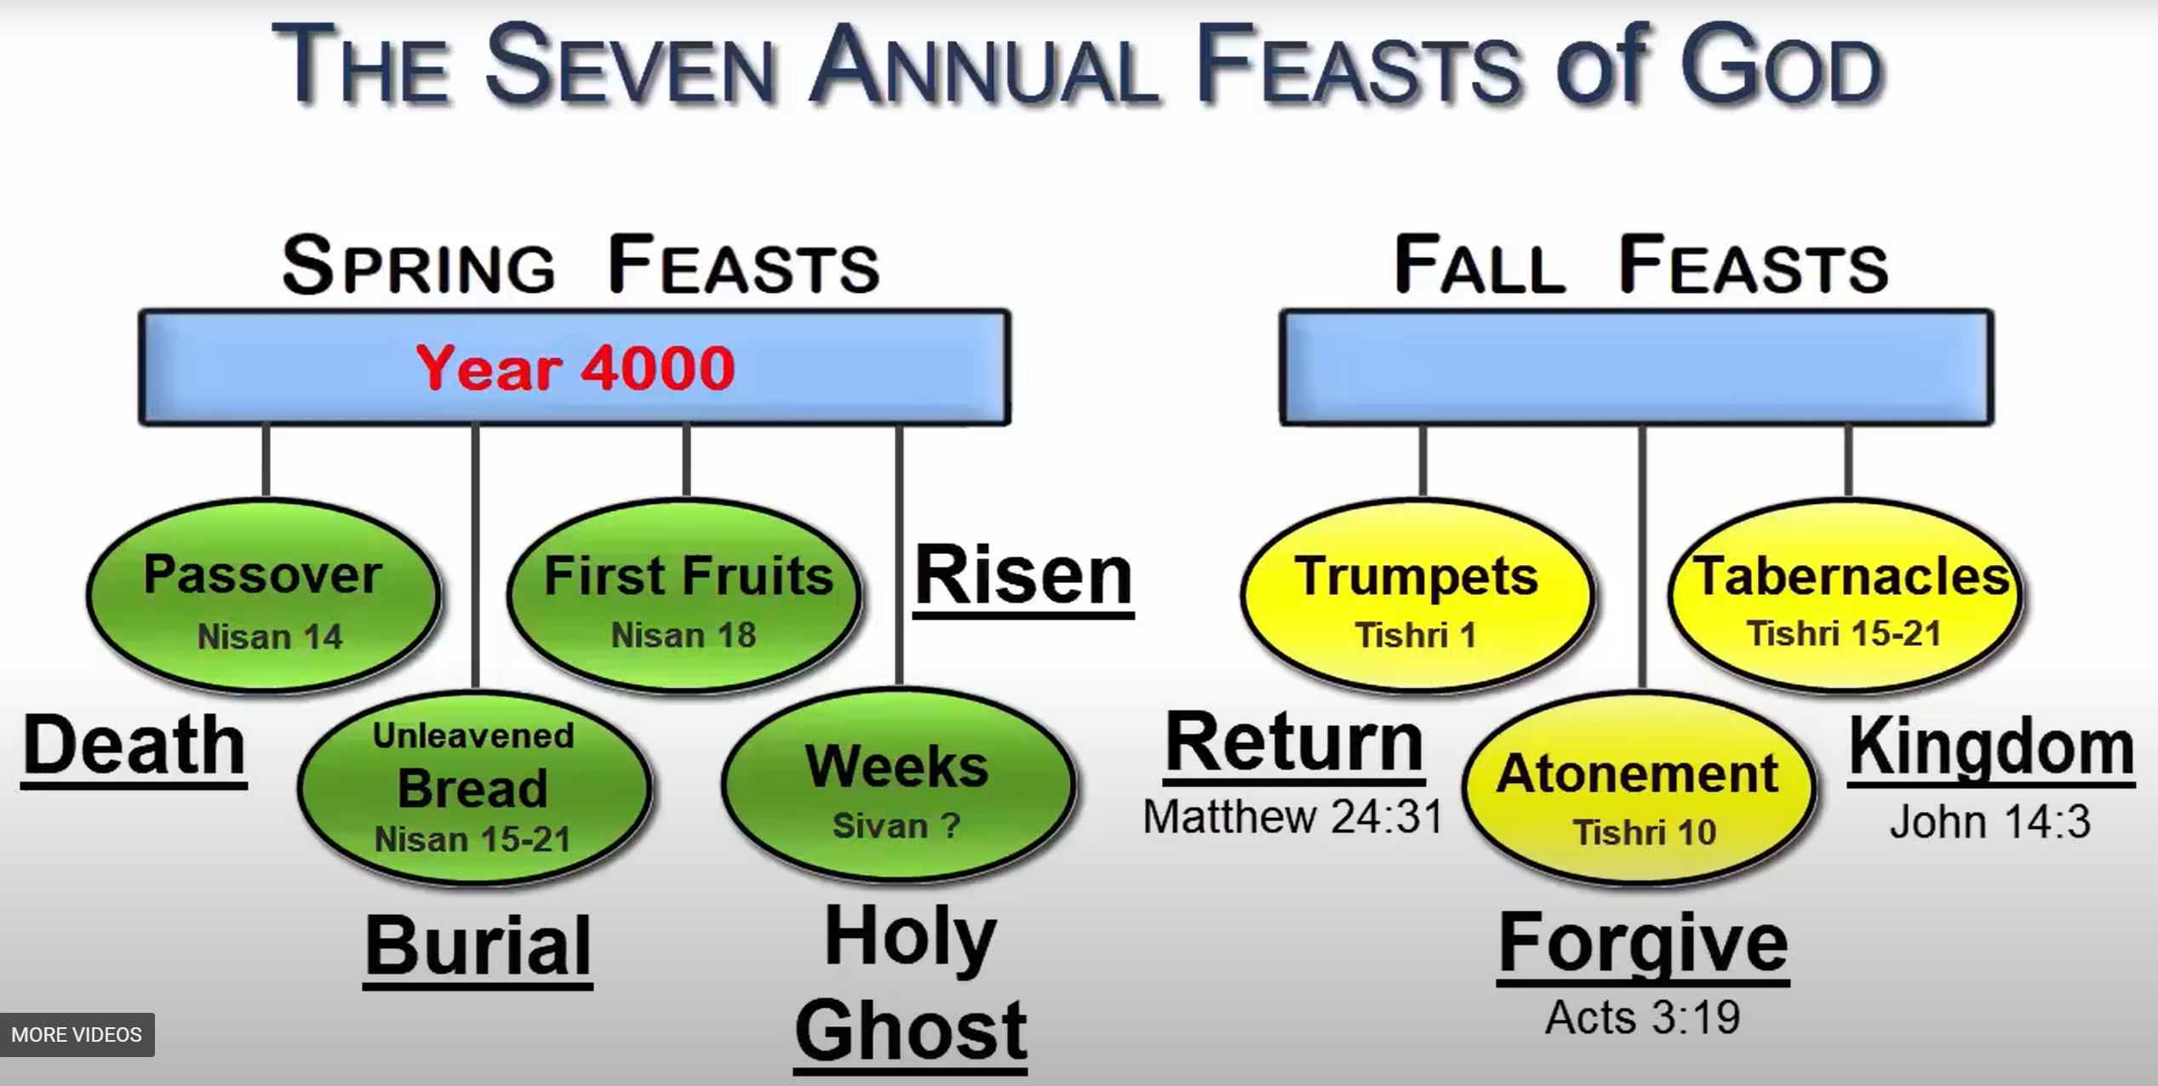

Slide 32
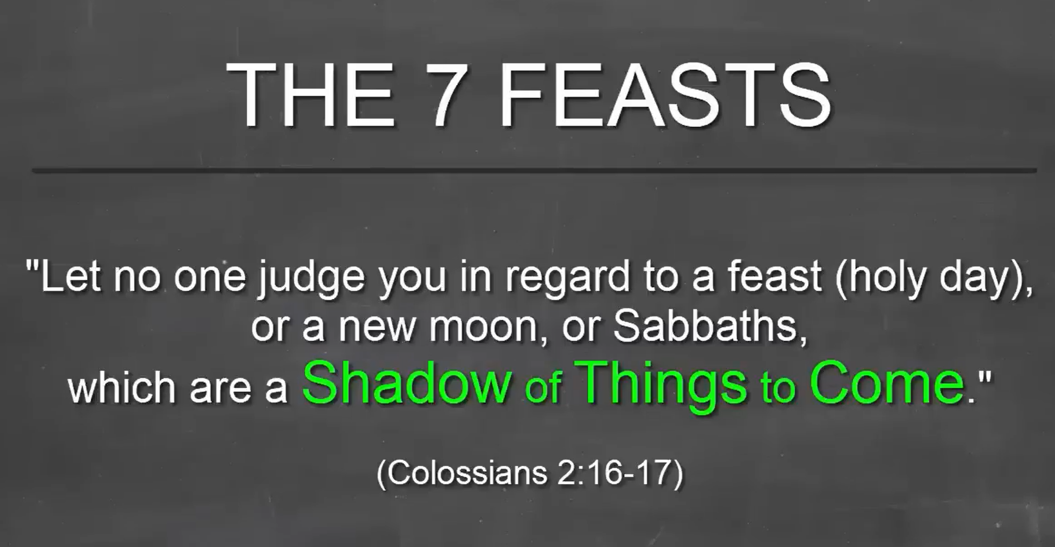

Slide 33
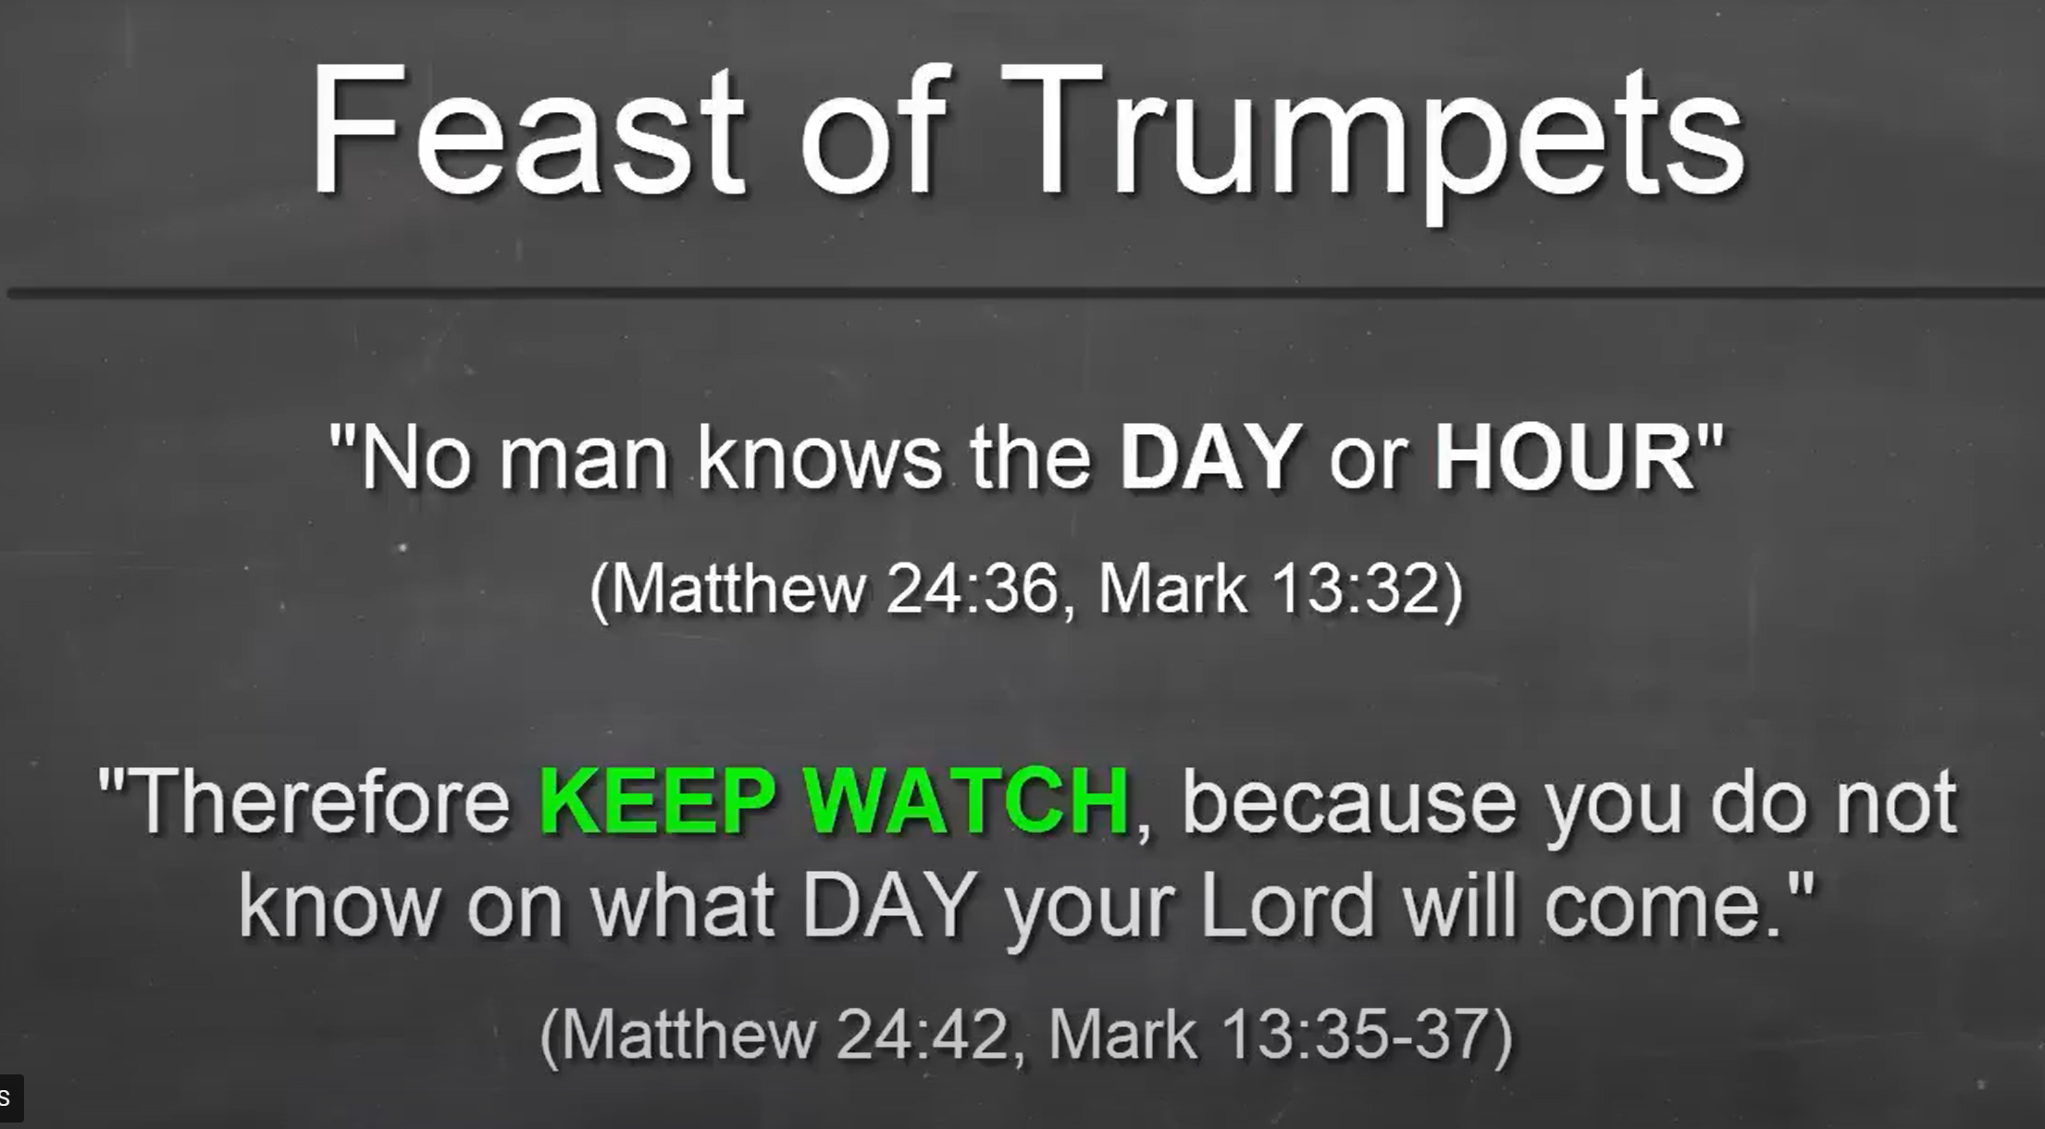

Slide 34
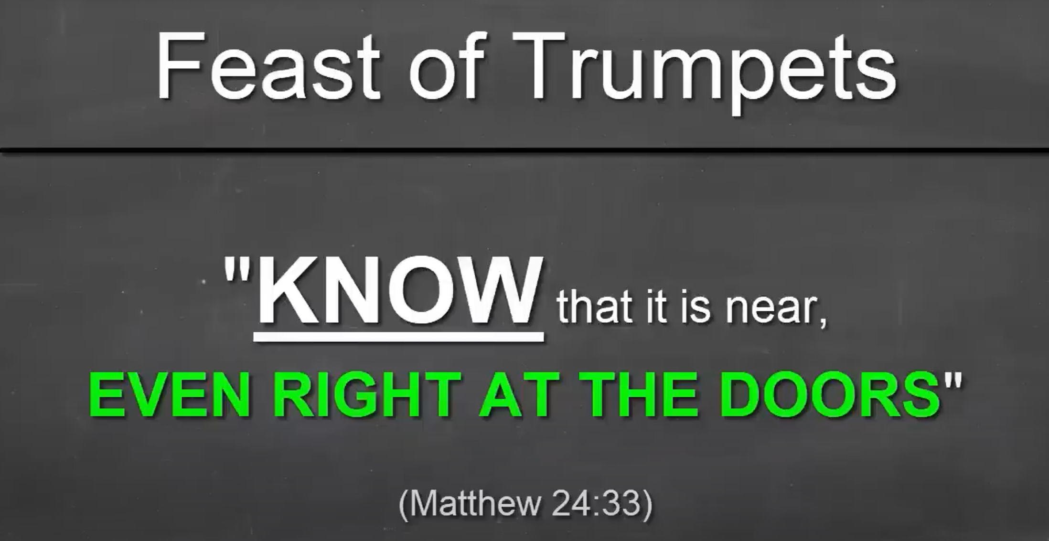

Slide 35
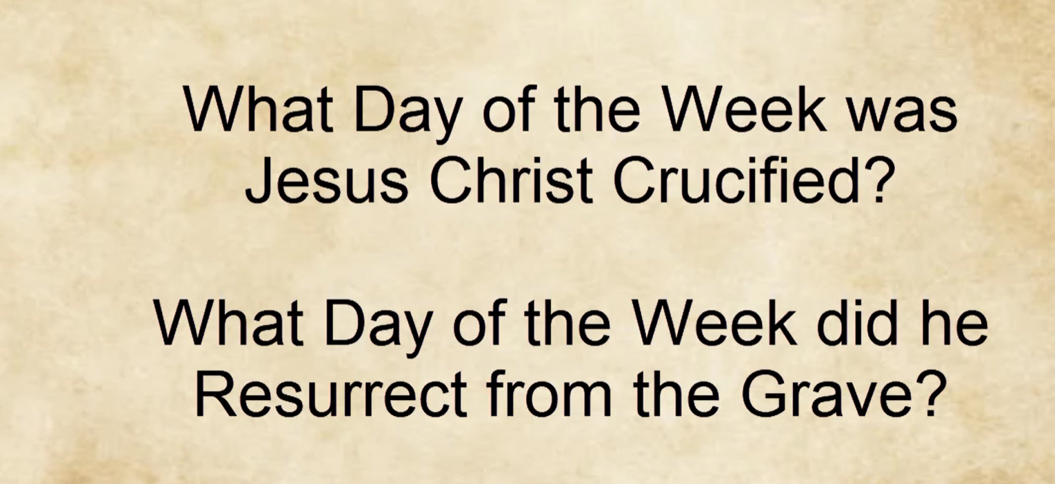

Slide 36
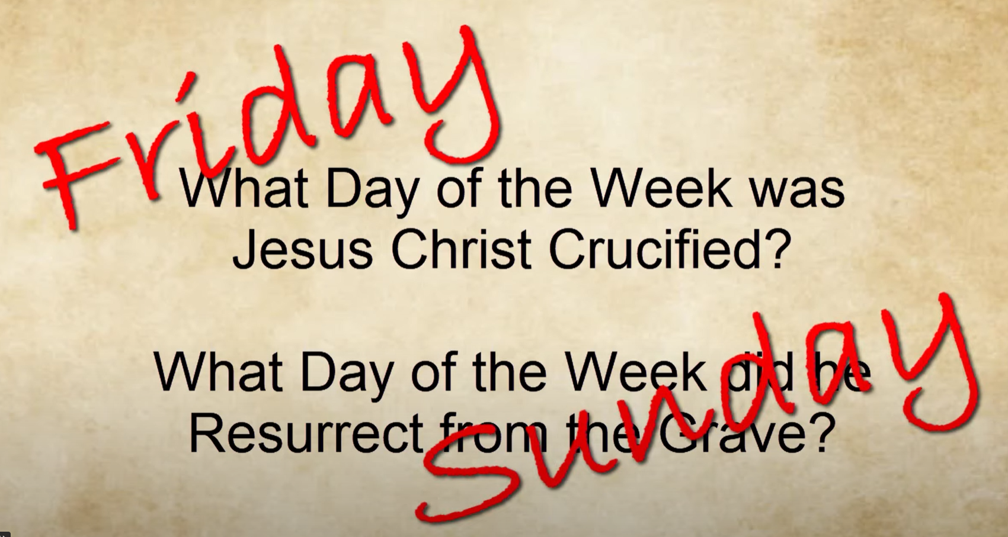

Slide 37
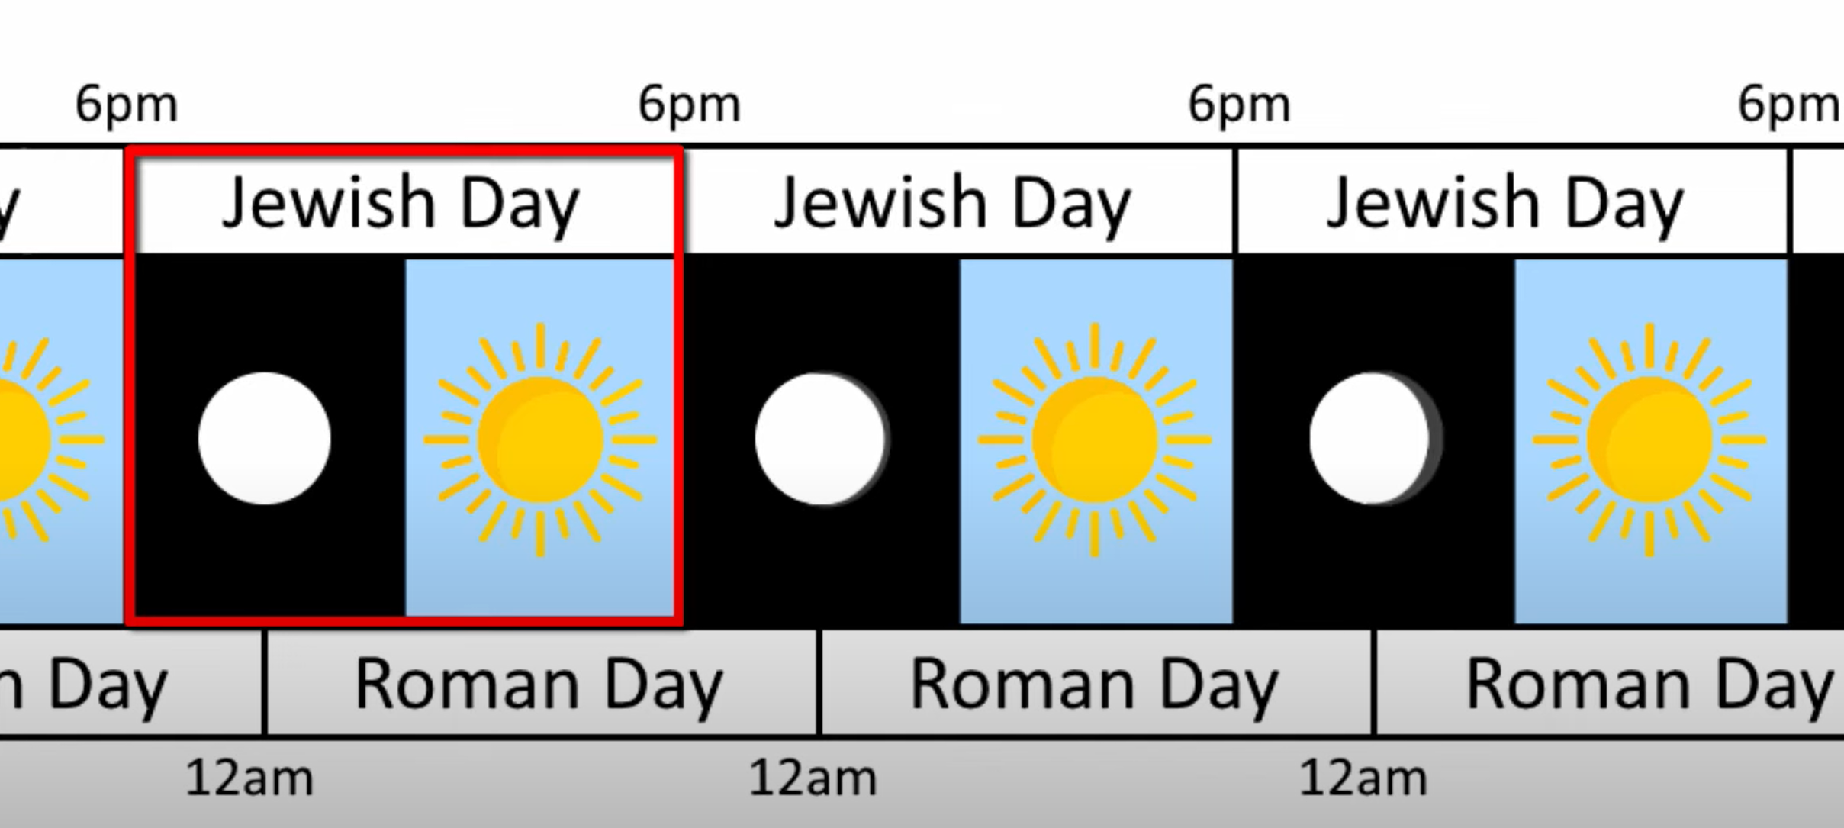

Slide 38
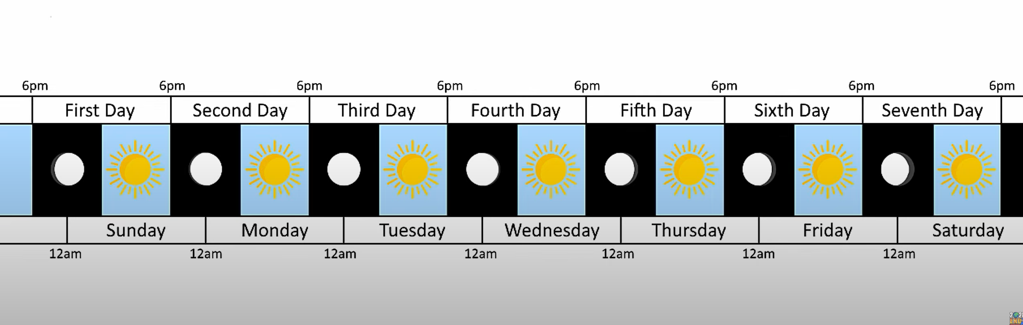

Slide 39
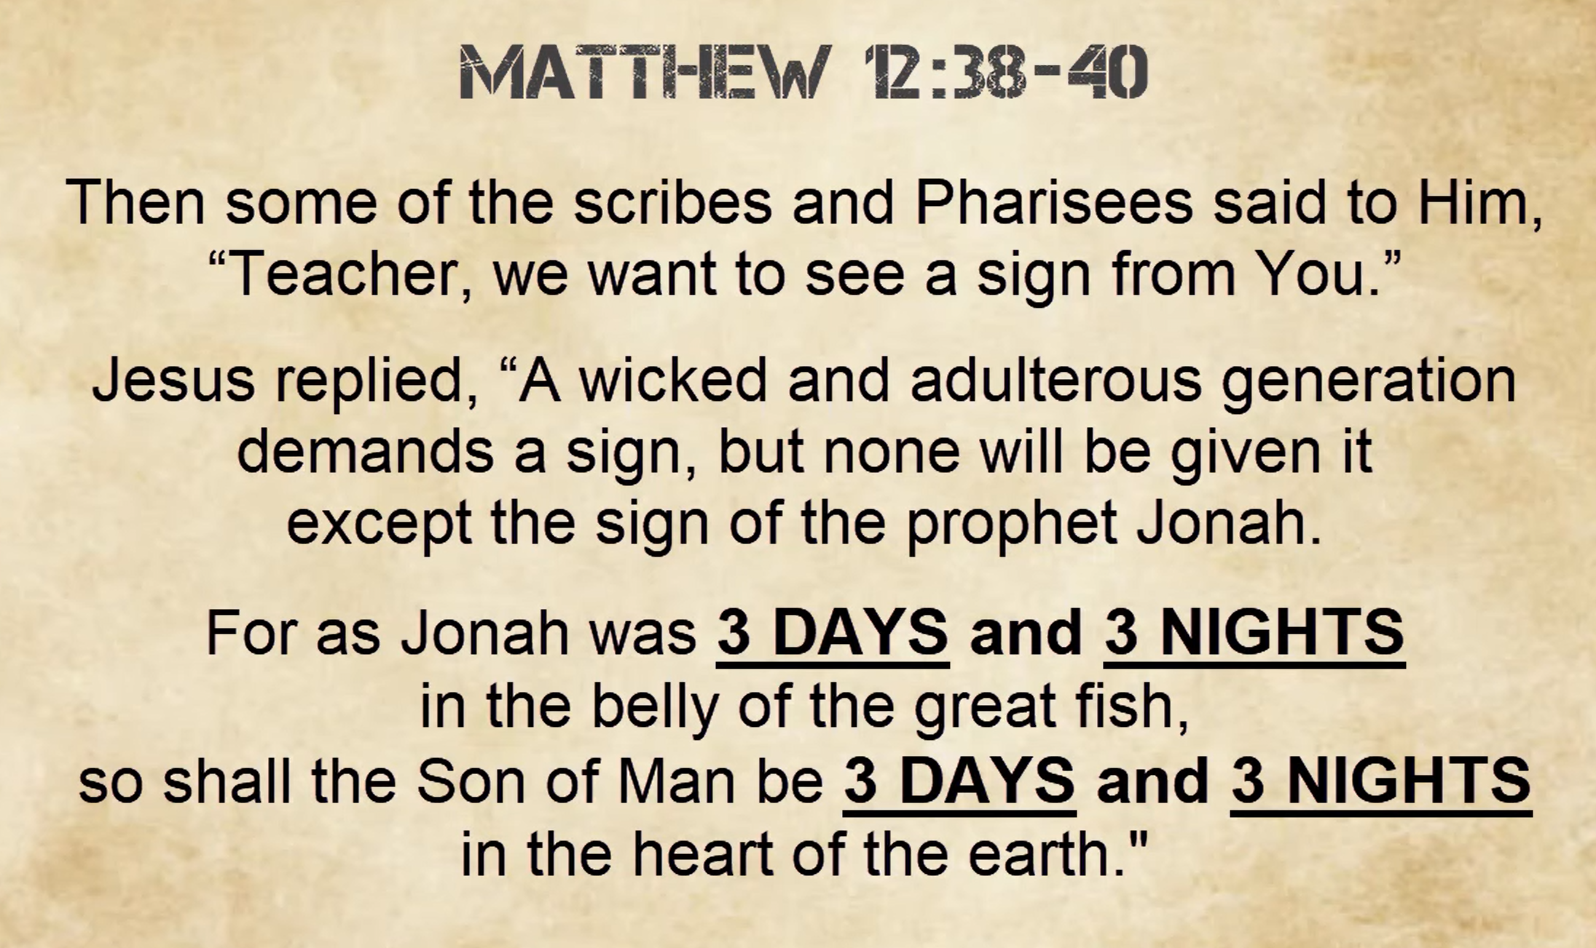

Slide 40
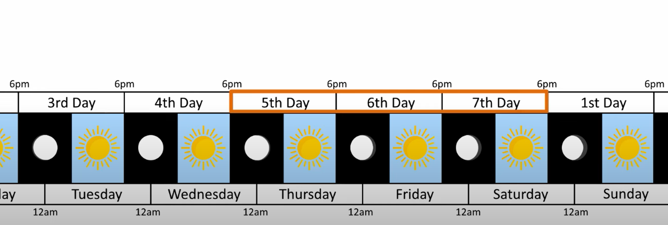

Slide 41
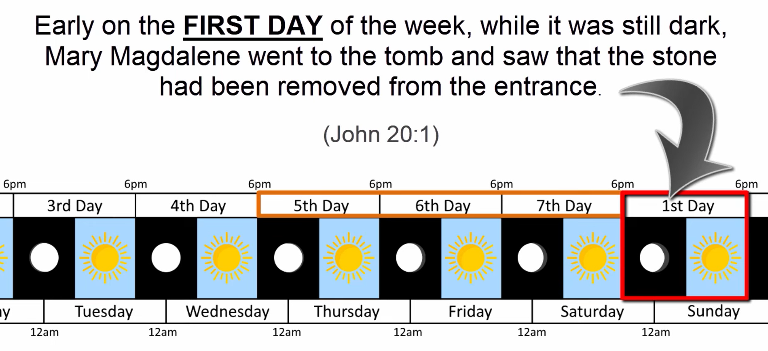

Slide 42
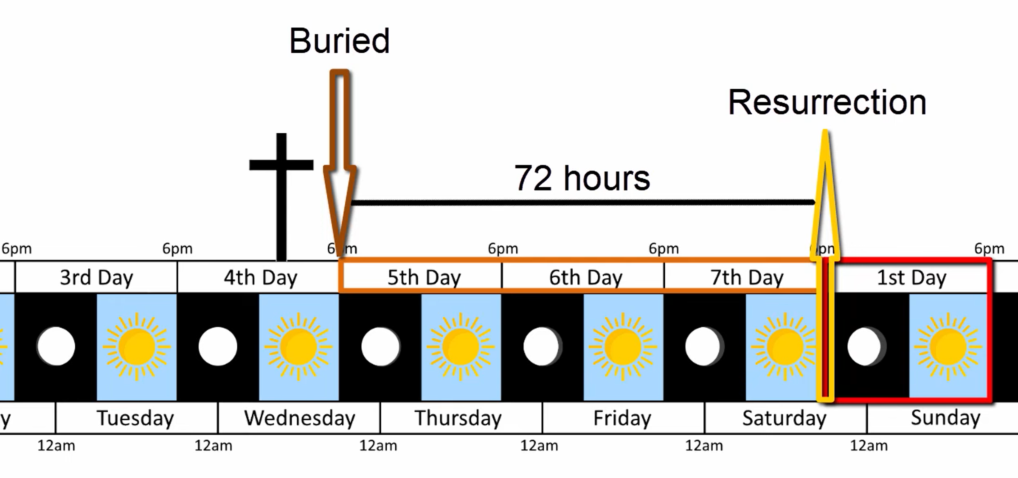

Slide 43
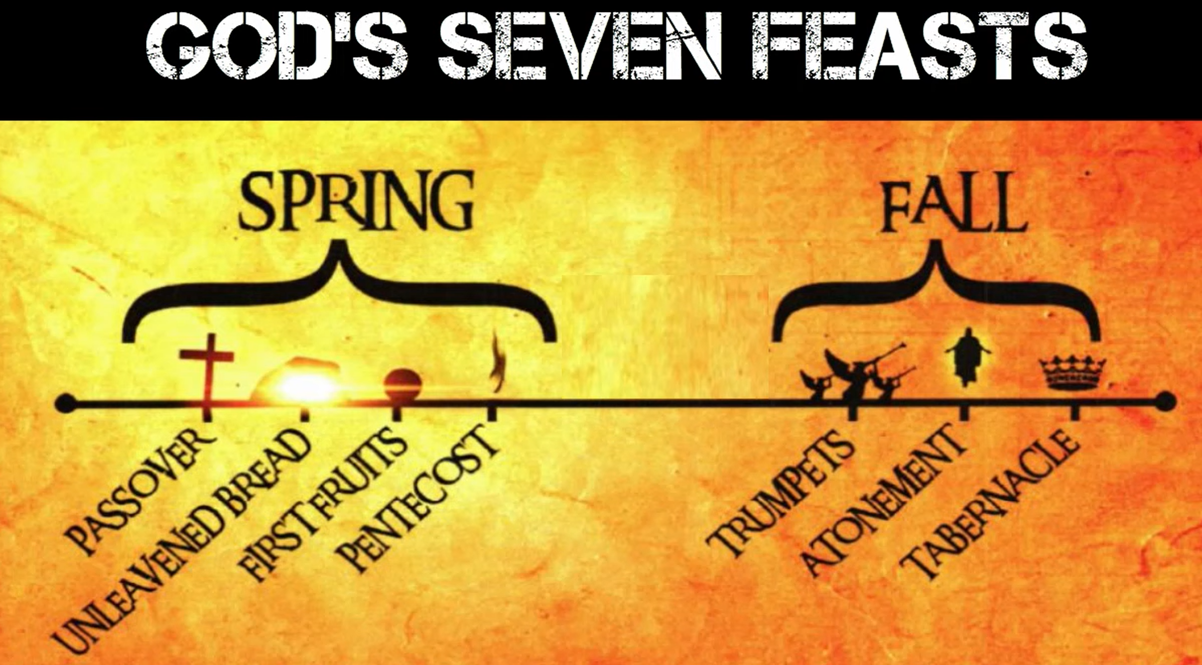

Slide 44
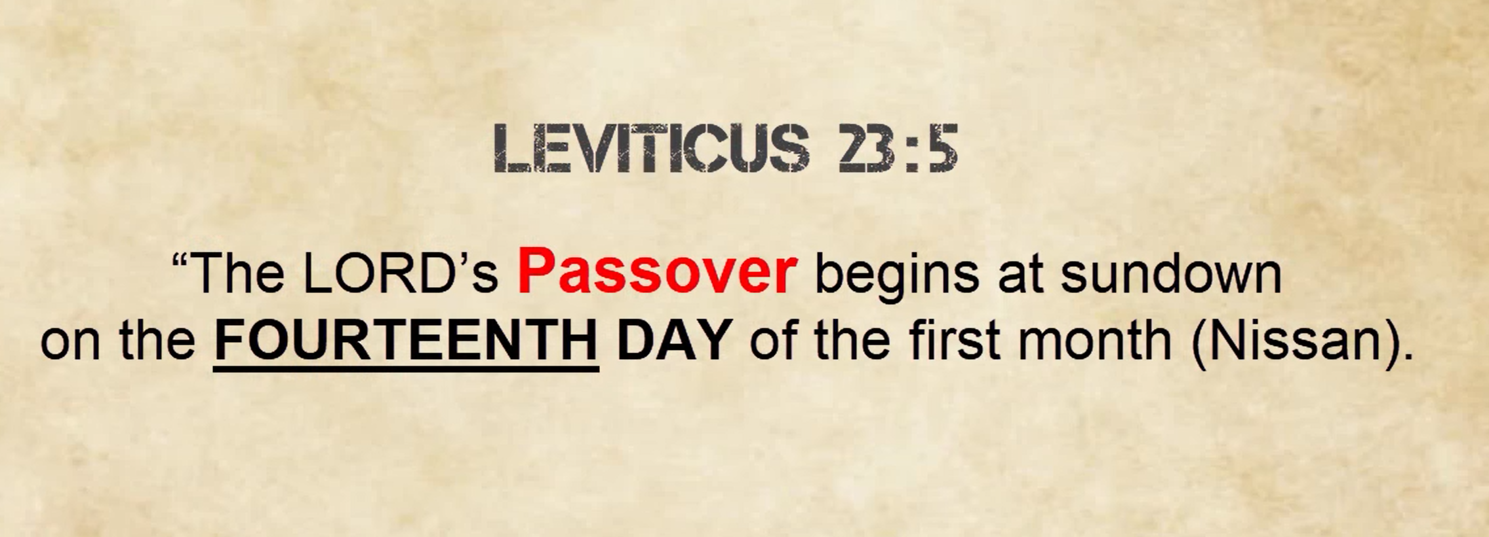

Slide 45
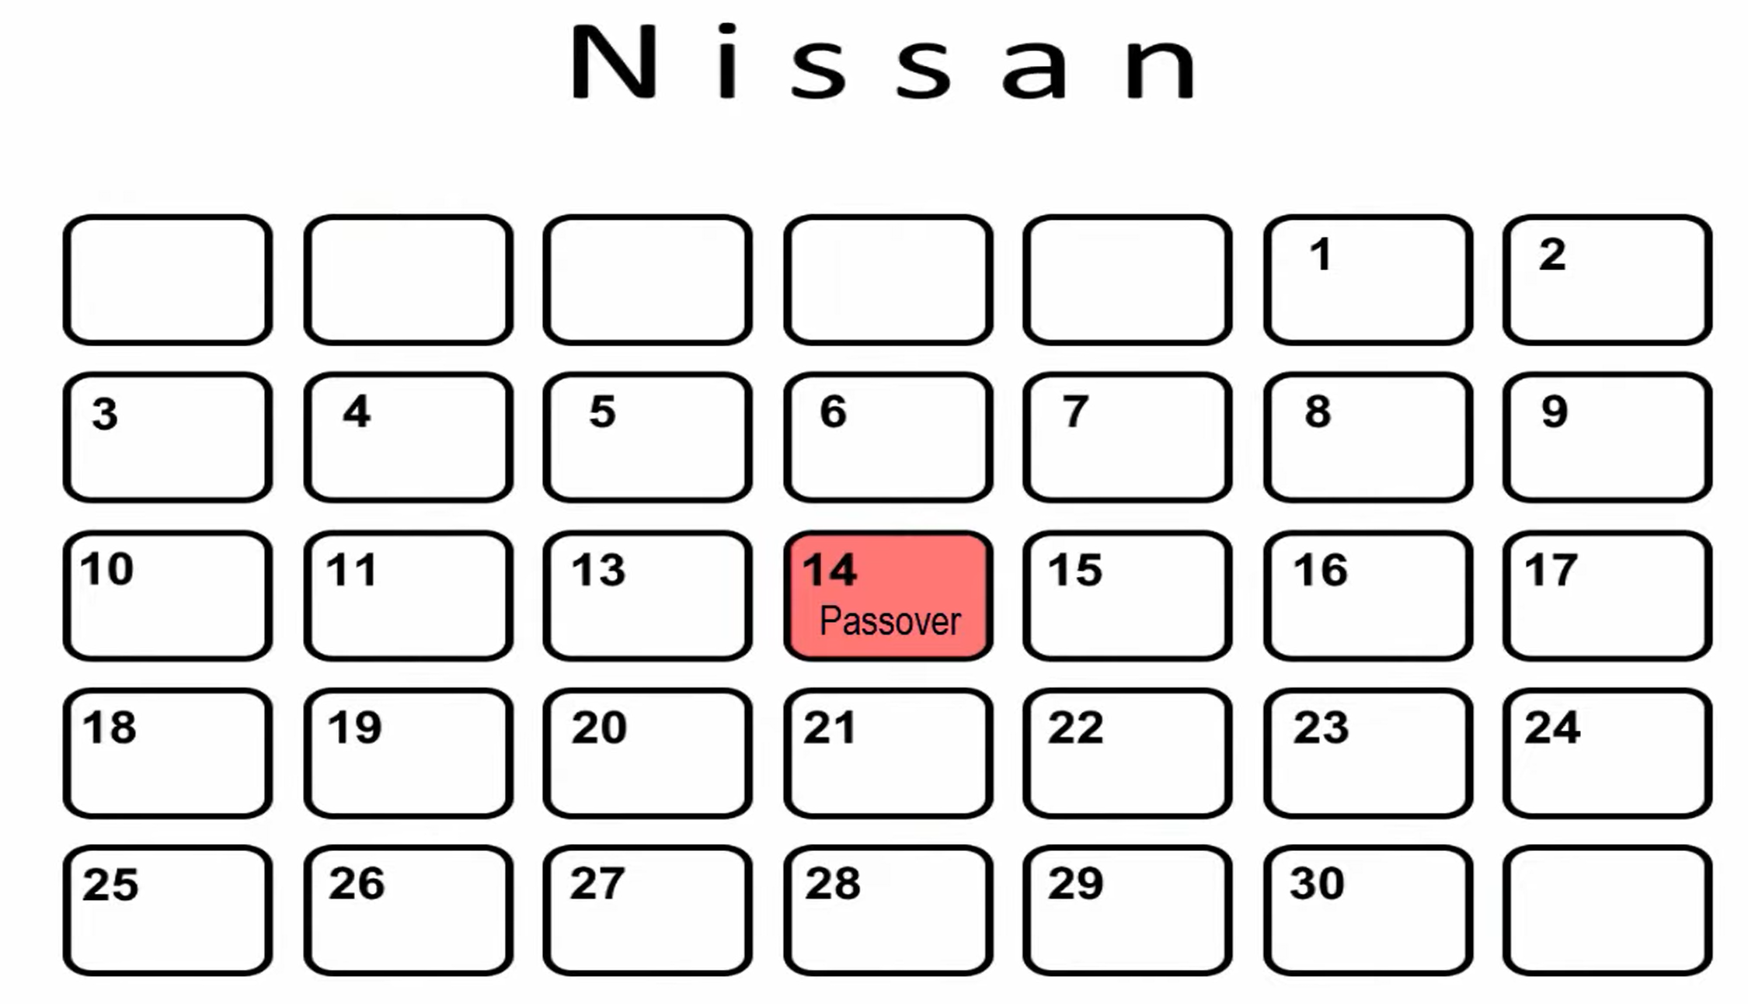

Slide 46
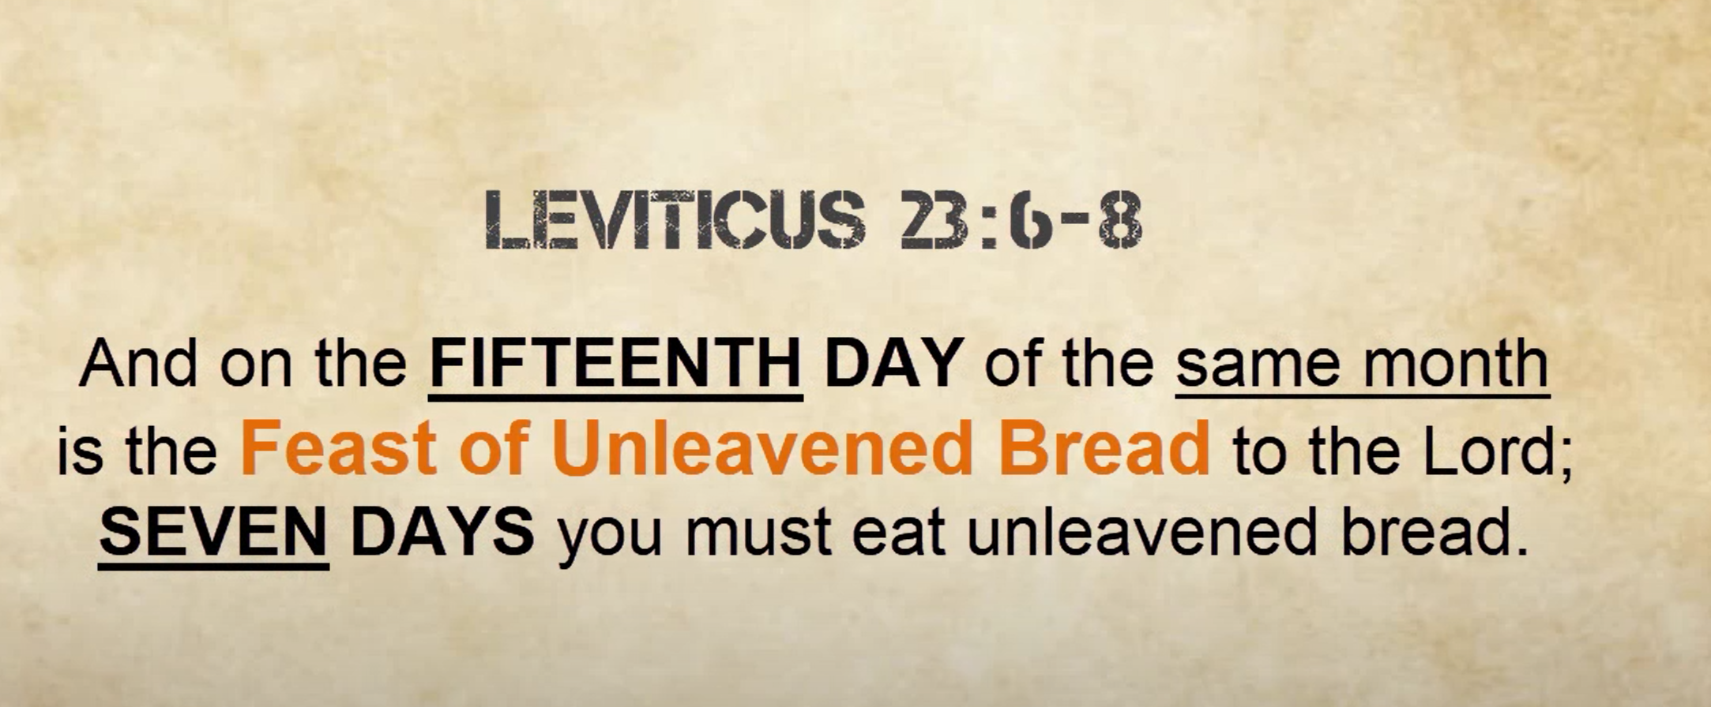

Slide 47
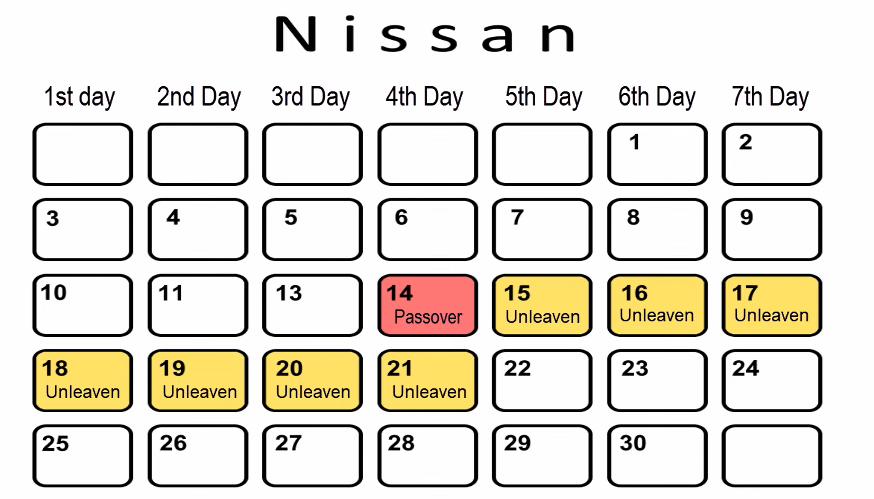

Slide 48
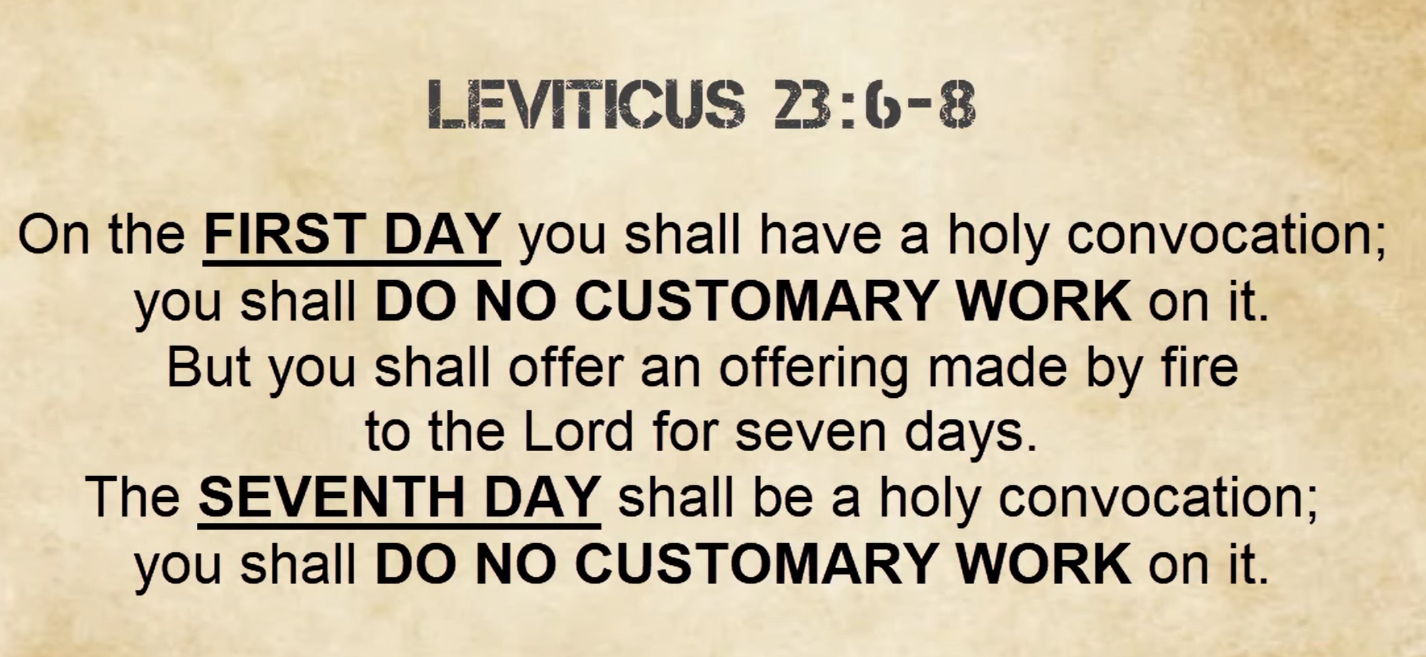

Slide 49
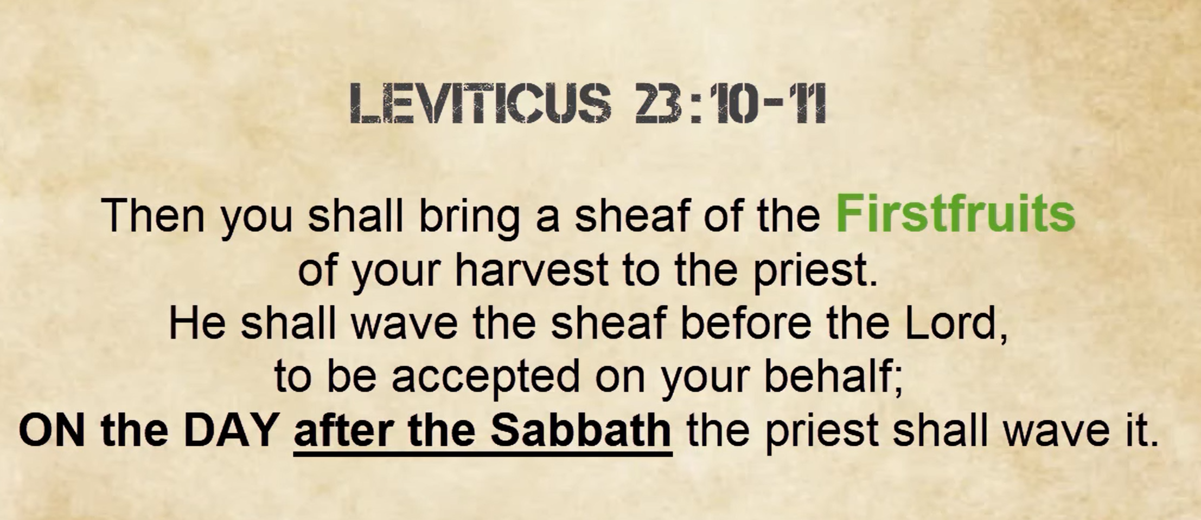

Slide 50
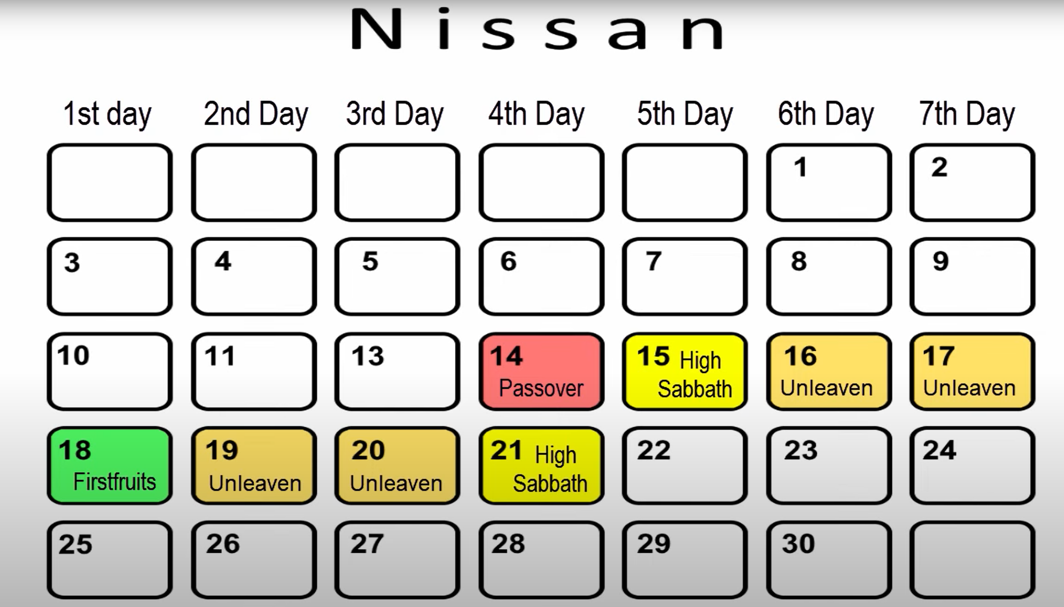

Slide 51
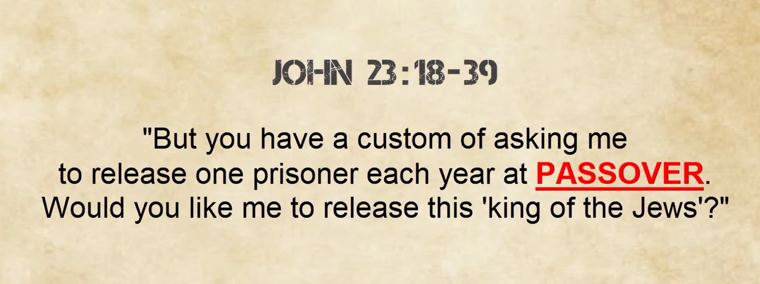

Slide 52
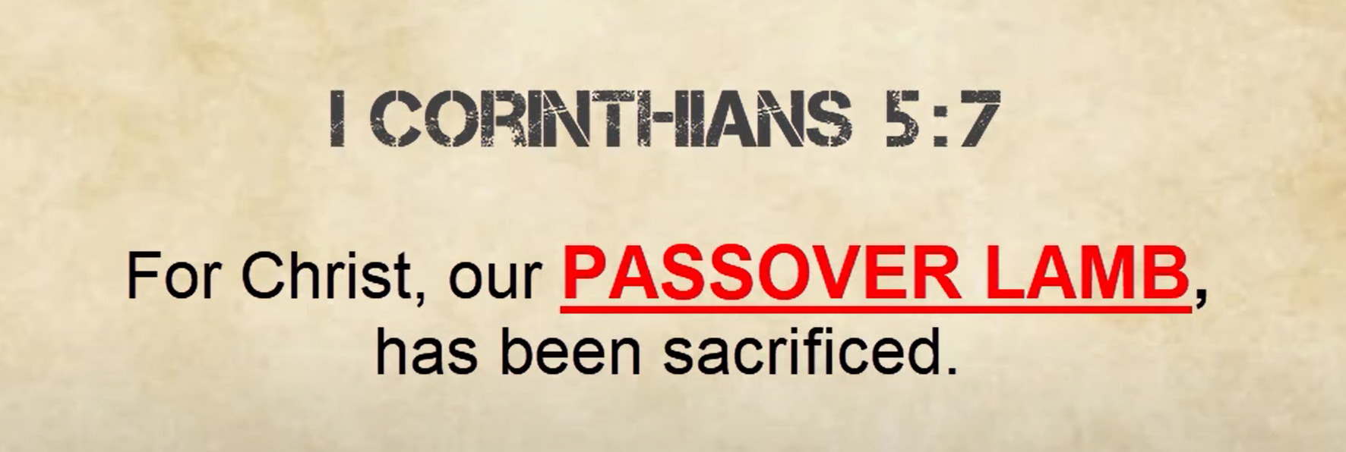

Slide 53
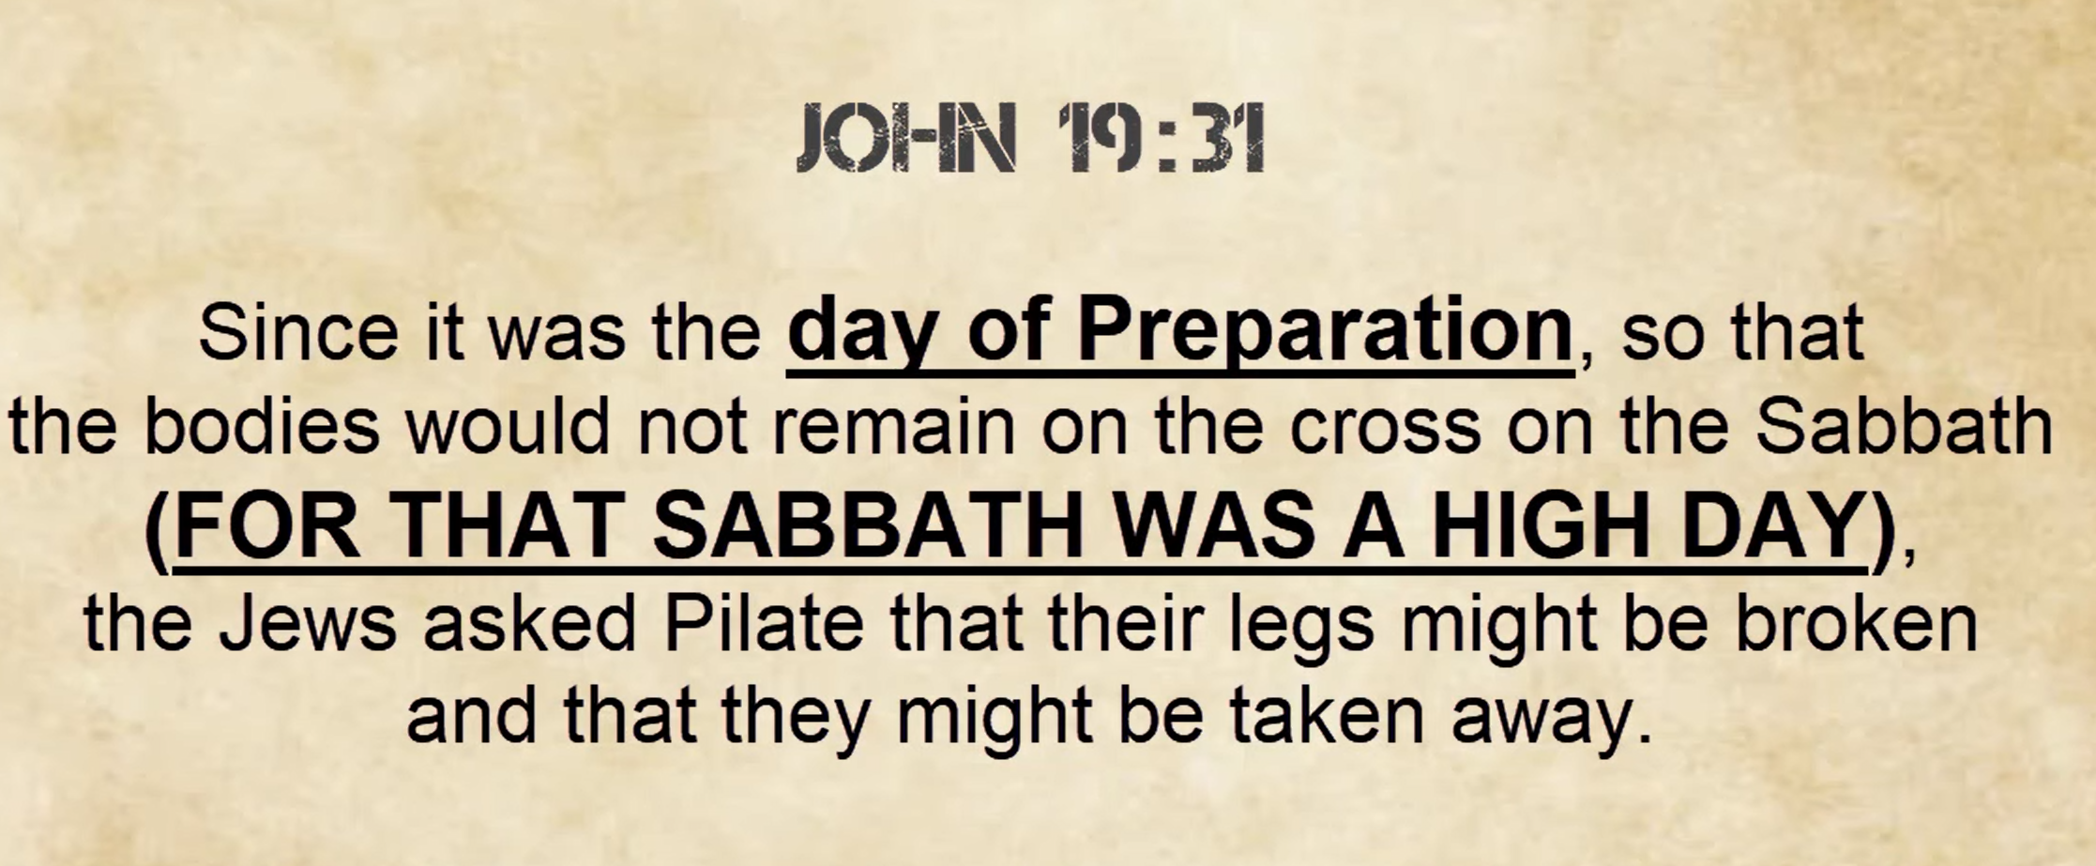

Slide 54
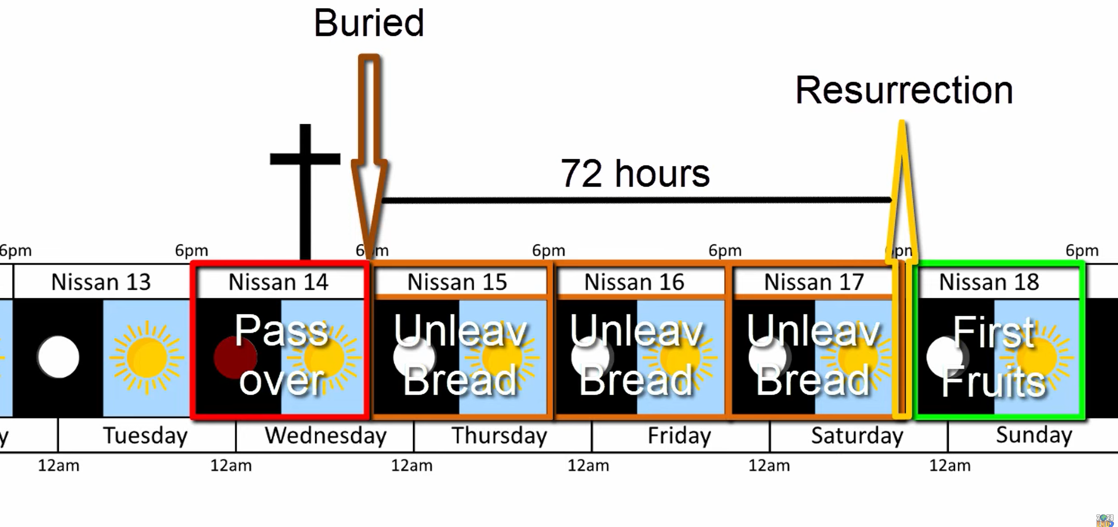

Slide 55
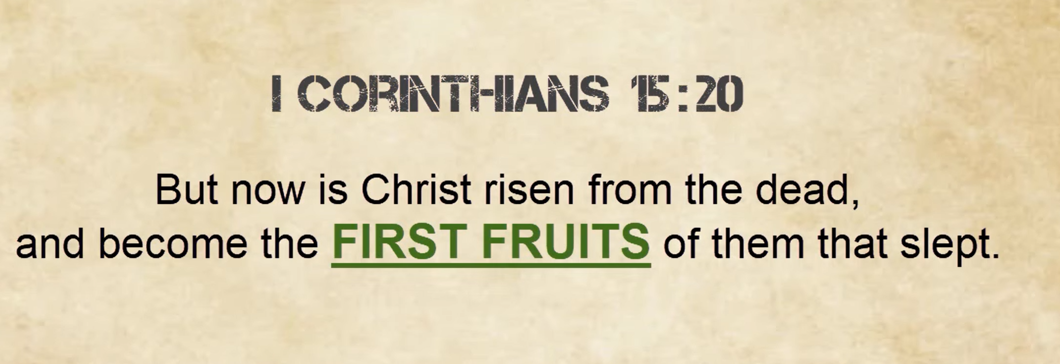

Slide 56
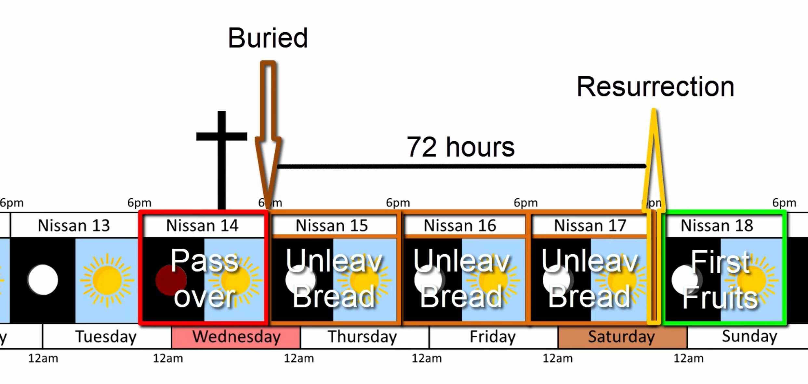

Slide 57
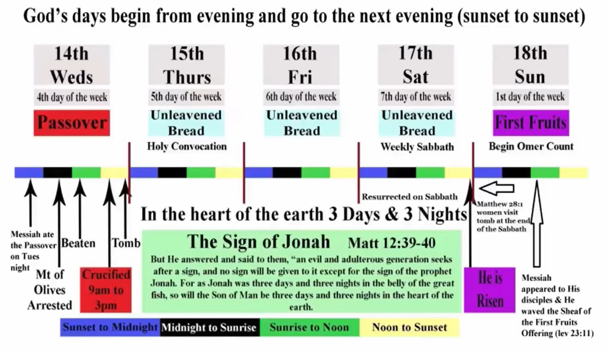

Slide 58
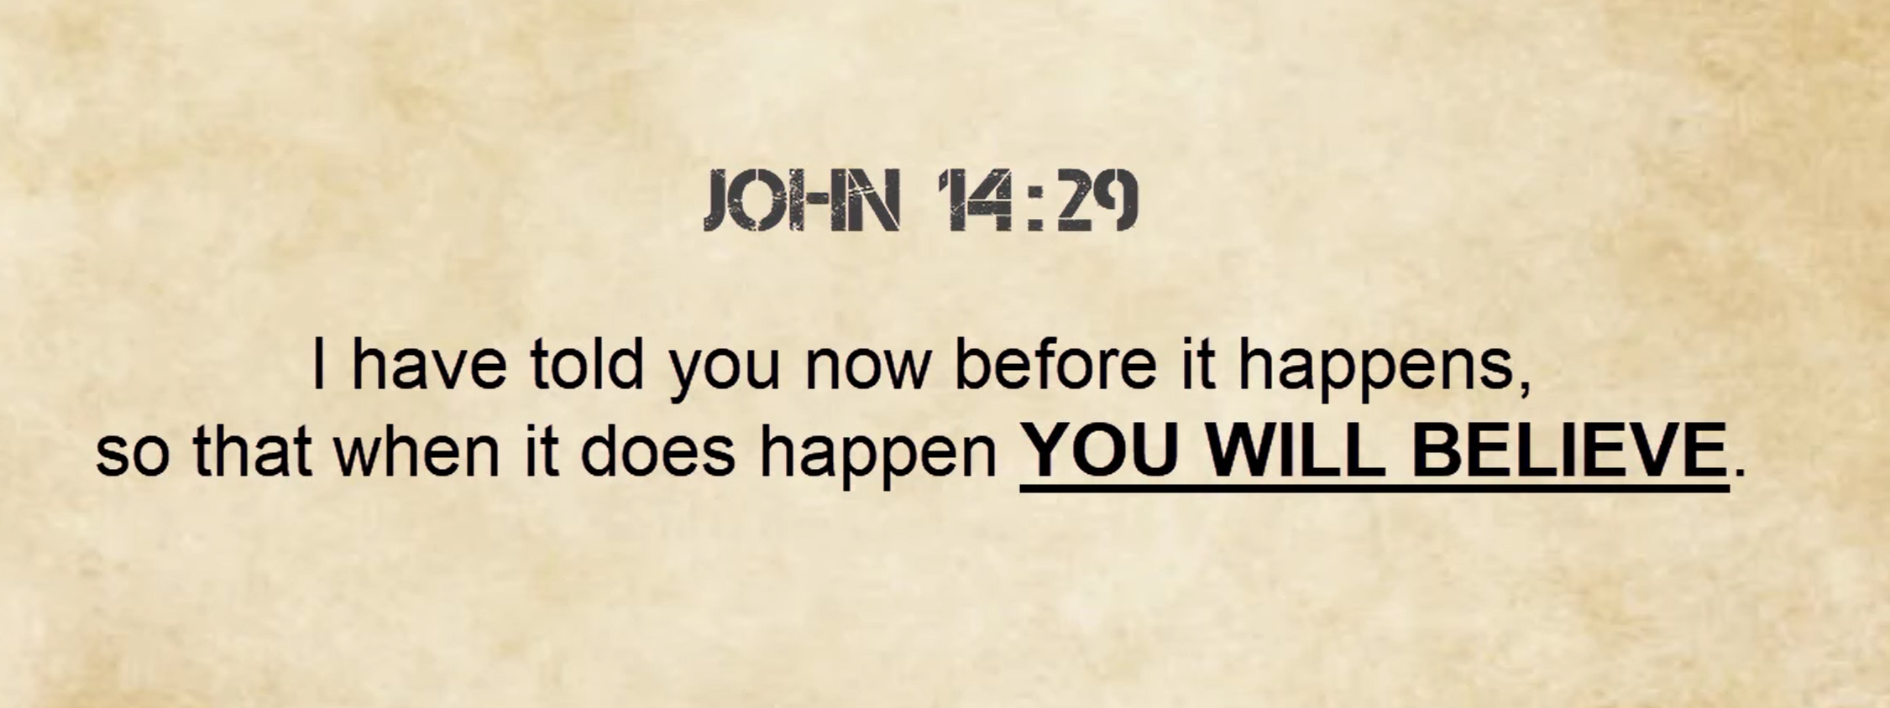

Slide 59
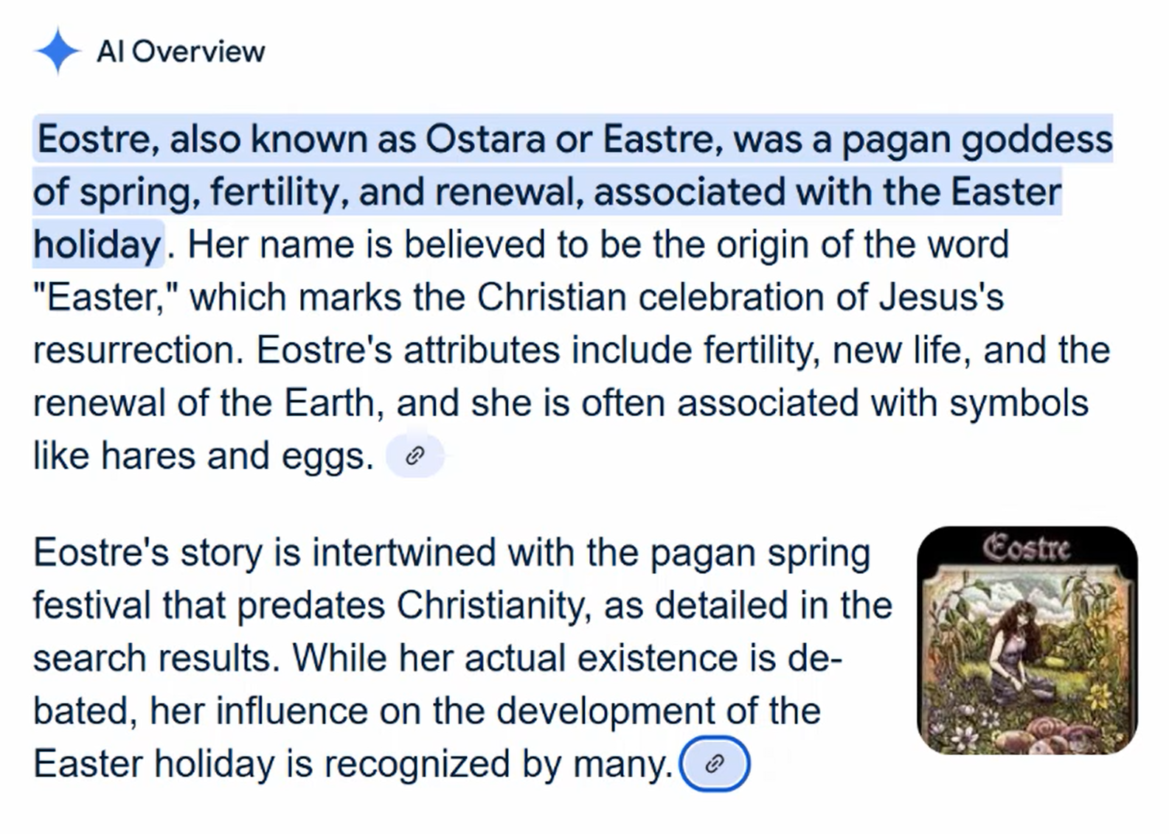

Slide 60
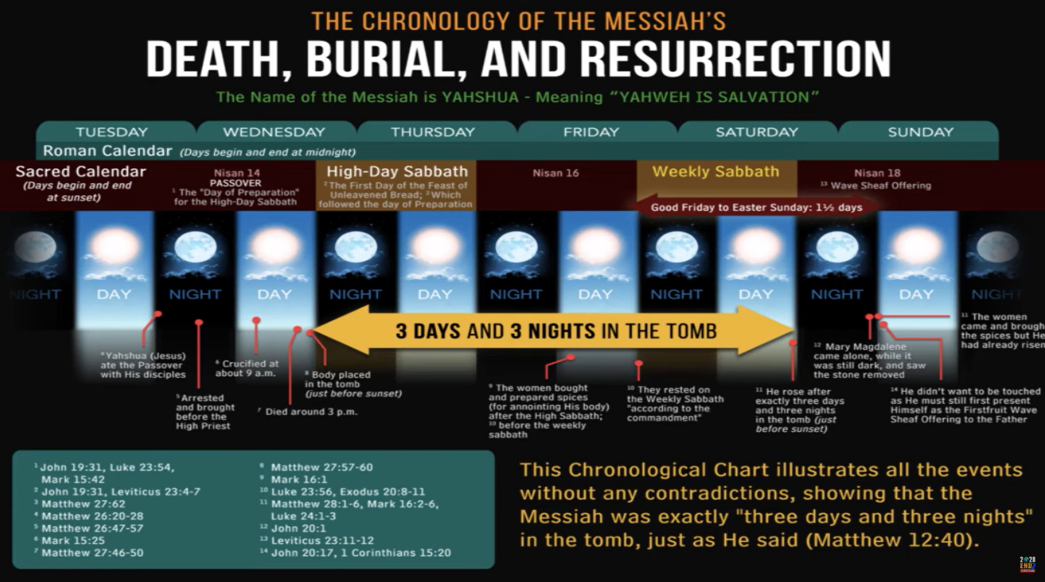

Slide 61
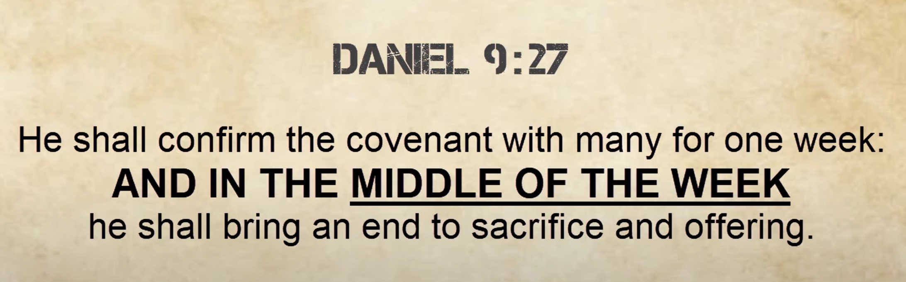

Slide 62
The Passover lamb is chosen on the 10th day of Nisan (also called Aviv), which is the first month of the Hebrew religious calendar. This typically falls in March or April in the Gregorian calendar.
According to the biblical instructions in Exodus 12:3-6, each household was to select a lamb on the 10th of Nisan and keep it until the 14th day of the same month, when it would be slaughtered at twilight. This four-day period allowed time to observe the lamb and ensure it was without blemish, as required for the sacrifice.
The lamb was then eaten that same night (which would be the beginning of the 15th of Nisan by Hebrew reckoning, since days begin at sunset), marking the start of the Feast of Unleavened Bread and commemorating the Israelites' exodus from Egypt.
This timing remains significant in Jewish Passover observance today, though the sacrificial system is no longer practiced since the destruction of the Temple in 70 CE.
Selecting the Passover lamb

Slide 63
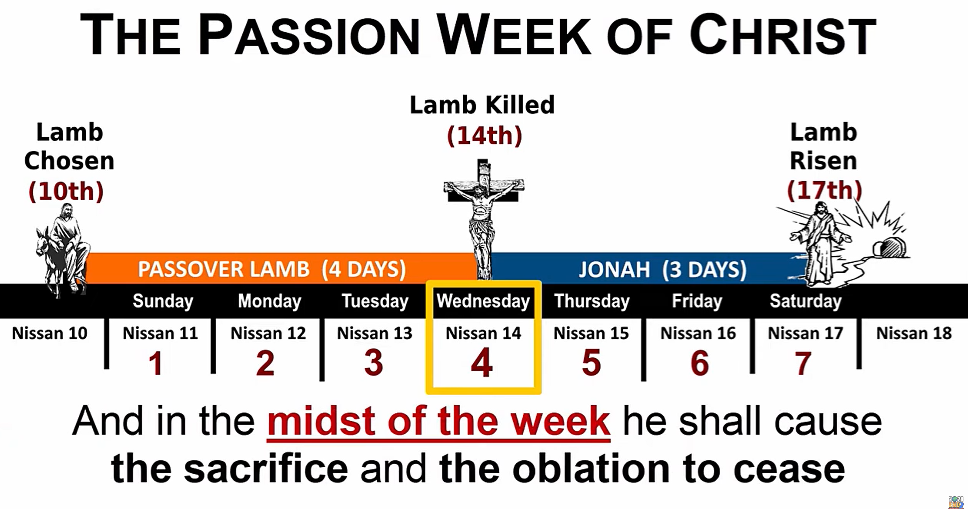

Slide 64


Slide 65


Slide 66


